Slide 1
AP World History 1/10/11
Please pick up a book and pass test corrections to the right.
Remember to post reflections and e-mail Stearns MC test to me no later than tomorrow prior to class.
Please answer the following prompt:
Compare the religious, social and geographical aspects of two of the three Muslim Empires

Slide 2
Sample Thesis
The Mughal and Ottoman Empires were both Muslim, although the Mughals attempted to blend in Hinduism from time to time. Both were somewhat tolerant of their non-Muslim citizens, but Muslim-Hindu strife was a major issue for the Mughals due to their location on the Indian sub-continent.

Slide 4
The Ottoman Empire
Mehmed II conquers Constantinople in 1453 and ends the 1000 year Byzantine Empire. Leaders are called sultans.
Constantinople is rebuilt and re-emerges as the center of trade. This will encourage the Portuguese to find a way around.
Sunni Islam, but tolerance for other religions.
Janissaries – slave troops – are the military core of the empire. Viziers run the bureaucracy.
Turkish is the official language.
Great emphasis on art, architecture, and literature, but not technology.

Slide 5
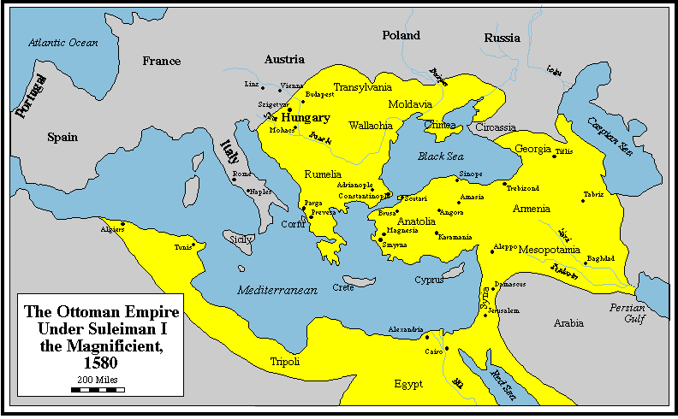
The Ottoman Empire

Slide 6
The Safavid Empire
Arises near modern-day Iran and embraces Shia Islam. Leaders are called Shahs. Imams and Mullahs (religious leaders) help govern.
Persian is the court language. Great emphasis on art, architecture, and literature.
Expansion until the Battle of Chaldiran against the Ottomans. Ottomans prevail, and Shia spread is stopped.
Ends in 18th century after problem with succession leaves no suitable leaders.

Slide 7
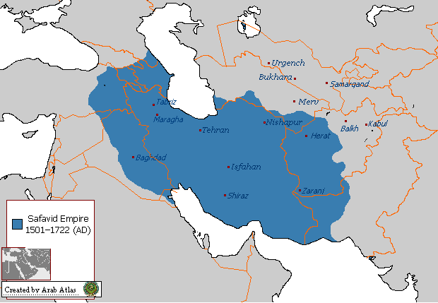
The Safavid Empire (Iran)

Slide 8
The Mughal Empire
Sunni: arises in India, but efforts to bring in Hindus.
Din-i-Ilahi is an effort to combine Hinduism and Islam. It eventually fails.
Social reforms sought to elevate the poor and women. Outlawing of Sati and easing of purdah.
The Taj Mahal built by Shah Jahan as a memorial to his wife Mumtaz Mahal
Aurangzeb attempts to cleanse Islam of Hindu impurities and opens rifts that continue to this day.

Slide 9
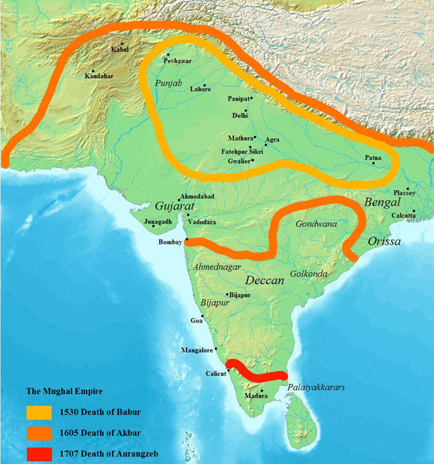
The Mughal Empire (India)

Slide 10
Principle of Succession
If you remember early Islamic history, Muhammad left no instructions on who was to succeed him as the leader of Islam. In other words, there was no principle of succession.
Shortly after his death, as a result of this oversight, the Sunni-Shia rift opened. Sunnis believed that the most suitable caliphs would be chosen by the community; The Shia believed it should be a descendent of Muhammad.
Subsequent Muslim societies continued to have problems with this lack of orderly succession.
This often lead to palace intrigue, manipulation, distrust and murder. It was not uncommon for a sultan, shah, caliph, or emperor to murder his offspring for fear that they would do the same to him in order to seize power.
How have other societies chosen their new leaders?

Slide 11
Suleyman the Magnificent
The greatest of the Ottoman Sultans.
Tolerated other religions, appreciated the arts, and trusted slaves.
But also murdered his children out of fear they would overthrow him.

Slide 12
Suleymaniye Mosque (1550)

Slide 13
Tughra (Imperial Cipher) of Suleyman the Magnificent (r. 1520-1566)

Slide 14
Sword, (ca. 1525-30) Steel, walrus ivory, gold, silver, rubies, turquoise, pearl.

Slide 15
Dish, (ca. 1525-30) Ottoman

Slide 16
Mirror, 16th century; Ottoman; Iron, ivory, and gold

