Slide 1
Automotive Technology Principles, Diagnosis, and Service
Sixth Edition
Chapter 24
Intake and Exhaust Systems
Copyright © 2018, 2015, 2011 Pearson Education, Inc. All Rights Reserved

Slide 2
LEARNING OBJECTIVES (1 of 2)
24.1 Explain air intake filtration.
24.2 Discuss the throttle-body injection intake manifolds and port fuel-injection intake manifolds.
24.3 Discuss exhaust gas recirculation passages and exhaust manifolds.

Slide 3
LEARNING OBJECTIVES (2 of 2)
23.4 Describe the purpose and function of mufflers.
23.5 Describe the purpose and function of variable intake manifolds.

Slide 4
AIR INTAKE FILTRATION
Air movement into an engine occurs due to low pressure (vacuum) being created in the engine.
The three main jobs of the air cleaner and filter include:
Clean the air before it is mixed with fuel
Silence intake noise
Act as a flame arrester in case of a backfire

Slide 5
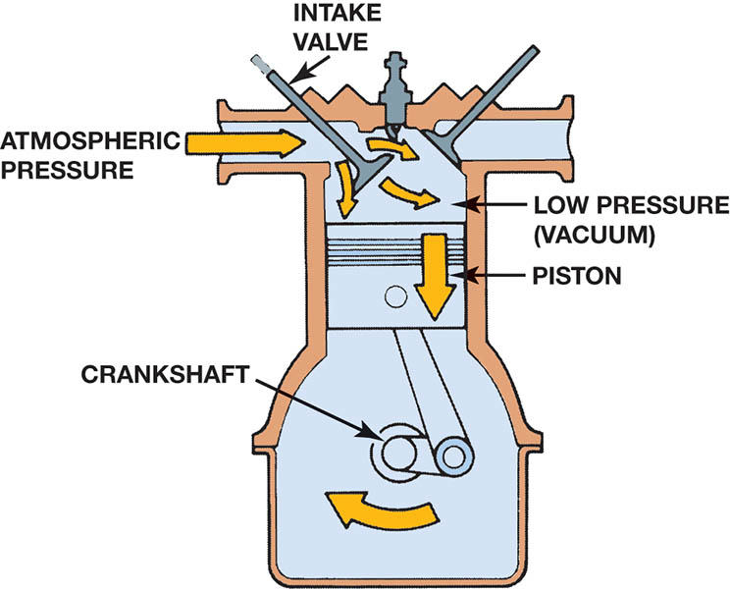
Figure 24.1 Downward movement of the piston lowers the air pressure inside the combustion chamber. The pressure differential between the atmosphere and the inside of the engine forces air into the engine

Slide 6
AIR FILTER ELEMENTS
Most air filters are capable of trapping dirt and other particles larger than 10 to 25 microns in size. One micron is equal to 0.000039 inch.
Manufacturers recommend cleaning or replacing the air filter element at periodic intervals, usually listed in terms of distance driven or months of service.

Slide 7
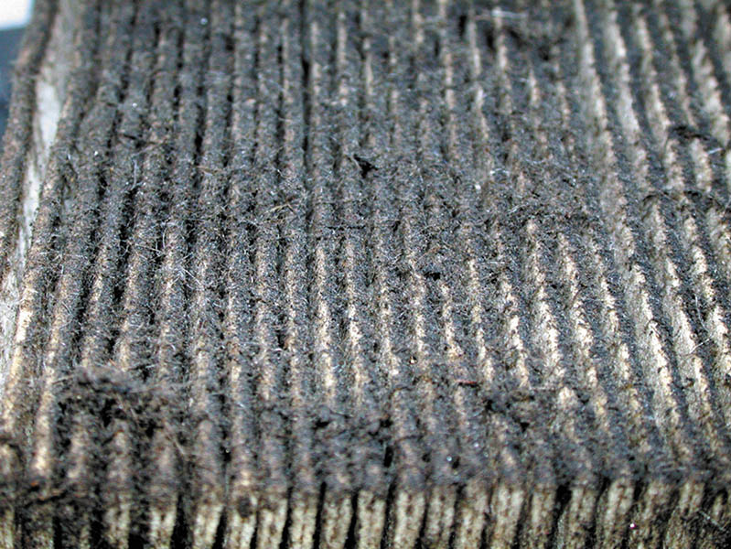
Figure 24.2 Dust and dirt in the air are trapped in the air filter so they do not enter the engine

Slide 8
AIR FILTERS AND DUCT S
Air cleaner and duct design depend on a number of factors, such as the size, shape, and location of other engine compartment components, as well as the vehicle body structure.
Some vehicles, especially pickup trucks that are often driven in dusty conditions, are equipped with an air filter restriction indicator.

Slide 9
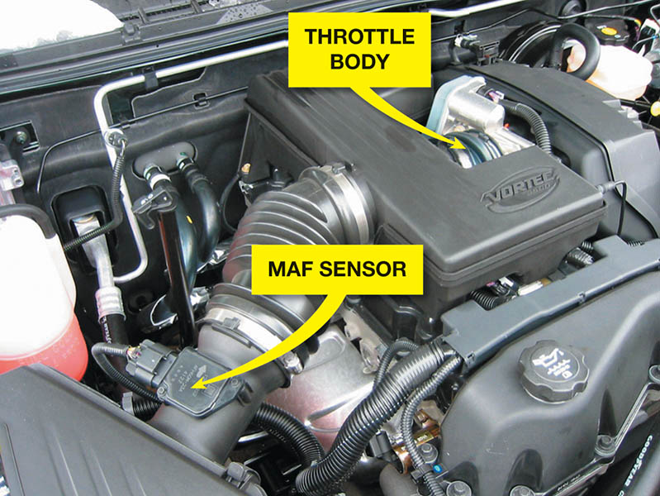
Figure 24.3 Most air filter housings are located on the side of the engine compartment and use flexible rubber hose to direct the airflow into the throttle body of the engine

Slide 10
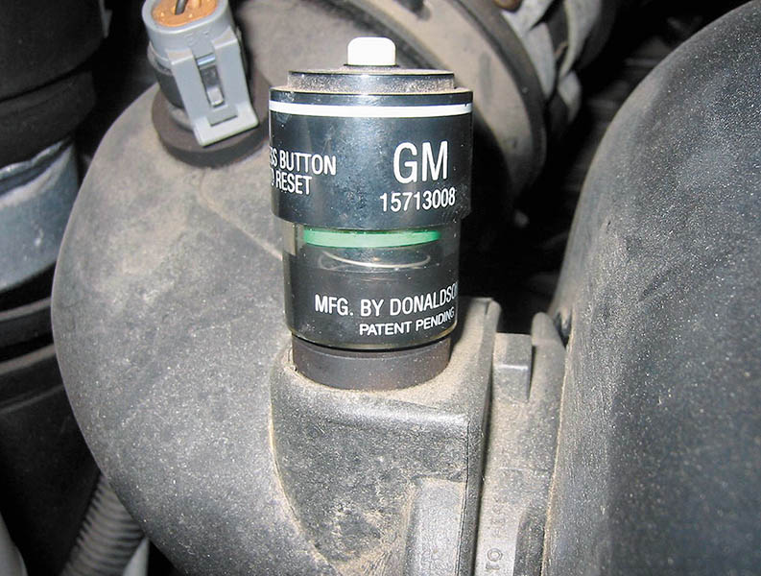
Figure 24.4 A typical air filter restriction indicator used on a General Motors truck engine. The indicator turns red when it detects enough restriction to require a filter replacement

Slide 11
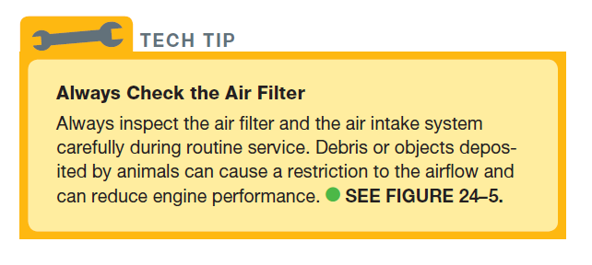
Tech Tip

Slide 12
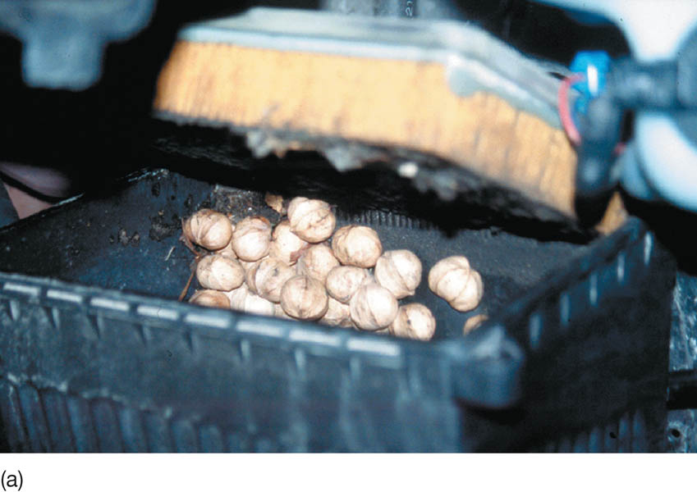
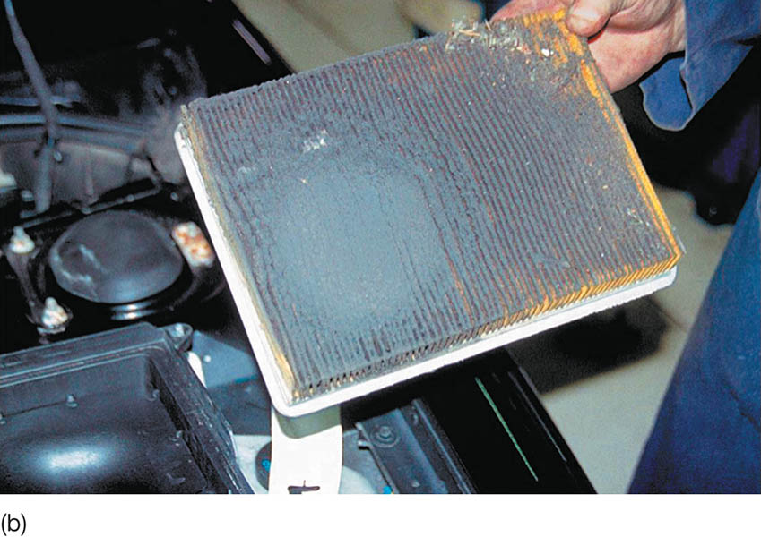
Figure 24.5 (a) Note the discovery as the air filter housing was opened during service on a Pontiac. The nuts were obviously deposited by squirrels (or some other animal). (b) Not only was the housing filled with nuts, but also this air filter was extremely dirty, indicating that this vehicle had not been serviced for a long time

Slide 13
FREQUENTLY ASKED QUESTION

Slide 14
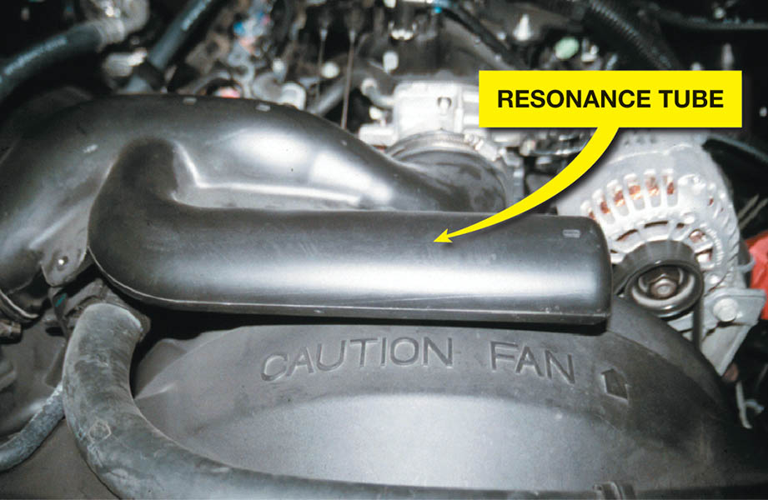
Figure 24.6 A resonance tube, called a Helmholtz resonator, is used on the intake duct between the air filter and the throttle body to reduce air intake noise during engine acceleration

Slide 15
QUESTION 1: ?
What are the three main jobs of the air cleaner and filter?

Slide 16
ANSWER 1:
Clean the air before it is mixed with fuel, silence intake noise, and
act as a flame arrester in case of a backfire.

Slide 17
FUEL-INJECTION INTAKE MANIFOLDS
The size and shape of port fuel-injected engine intake manifolds can be optimized because the only thing in the manifold is air.
Intake manifold runners are tuned to improve engine performance.
Long runners build low-RPM torque.
Shorter runners provide maximum high-RPM power.

Slide 18
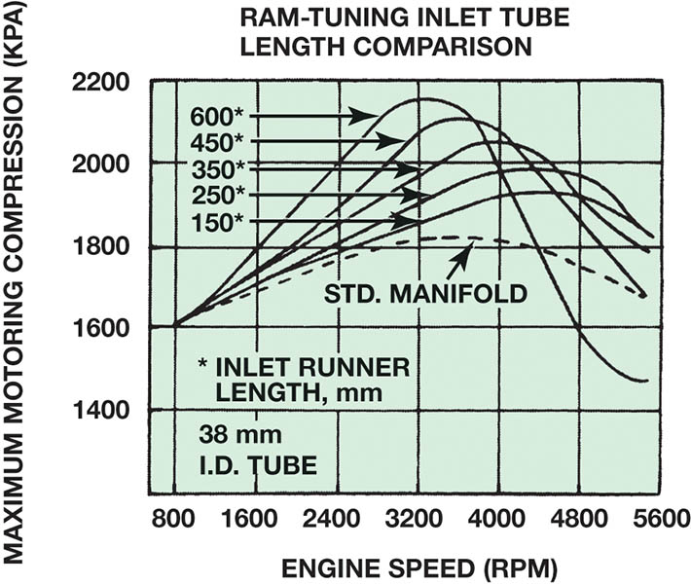
Figure 24.7 The graph shows the effect of sonic tuning of the intake manifold runners. The longer runners increase the torque peak and move it to a lower RPM. The 600 mm intake runner is about 24 inches long

Slide 19
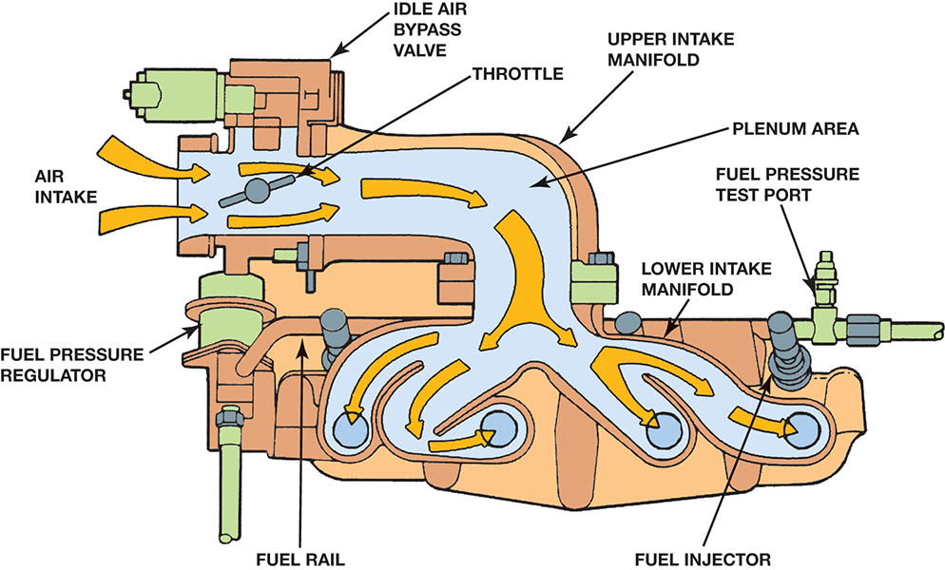
Figure 24.8 Airflow through the large-diameter upper intake manifold is distributed to smaller-diameter individual runners in the lower manifold in this two-piece manifold design

Slide 20
INTAKE MANIFOLD DESIGN (1 of 2)
Variable Intakes:
At lower engine speeds, long intake runners provide low-speed torque.
At higher engine speeds, short intake runners provide high-speed power.
Plastic Intake Manifolds:
Plastic intake manifolds have smoother interior surfaces than do other types of manifolds, resulting in greater airflow.

Slide 21
INTAKE MANIFOLD DESIGN (2 of 2)
Upper and Lower Intake Manifolds:
A lower section attaches to the cylinder heads and includes passages from the intake ports.
An upper manifold, usually called the plenum, connects to the lower unit and includes the long passages needed to help the ram air affect.
The use of a two-part intake manifold allows for easier manufacturing, as well as assembly, but can create additional locations for leaks.

Slide 22
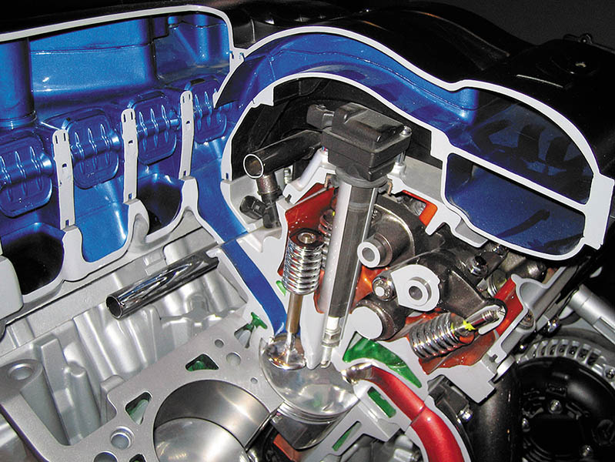
Figure 24.9 The air flowing into the engine can be directed through long or short runners for best performance and fuel economy

Slide 23
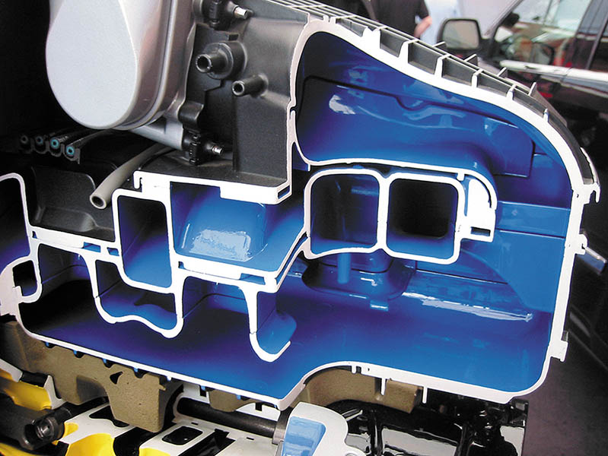
Figure 24.10 Many plastic intake manifolds are constructed using many parts glued together to form complex passages for airflow into the engine

Slide 24
VARIABLE INTAKE MANIFOLDS
Variable intake manifolds, commonly called a variable-length intake manifold (VLIM), allow the engine to produce a higher level of torque and horsepower over a wide range of engine speeds.
Vehicle manufacturers use different terms for their design of variable intake manifolds, such as variable intake system (VIS) or variable intake manifold (VIM).

Slide 25
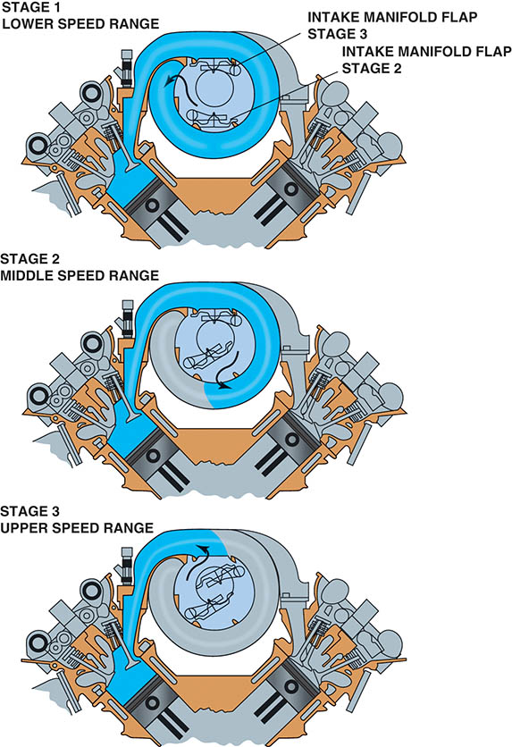
Figure 24.11 A typical variable intake manifold where the length of the intake passage is changed using a valve to change the direction of the airflow

Slide 26
QUESTION 2: ?
What is the benefit of a variable intake manifold?

Slide 27
ANSWER 2:
Higher torque at lower engine speeds and higher horsepower at higher engine speeds.

Slide 28
EXHAUST GAS RECIRCULATION PASSAGES
To reduce the emission of oxides of nitrogen (NOx), engines have been equipped with exhaust gas recirculation (EGR) valves.
Most EGR valves are mounted on the intake manifold.
On V-type engines, the intake manifold crossover is used as a source of exhaust gas for the EGR system.
On inline-type engines, an external tube is generally used to carry exhaust gas to the EGR valve.
Some systems use external EGR coolers.
.

Slide 29
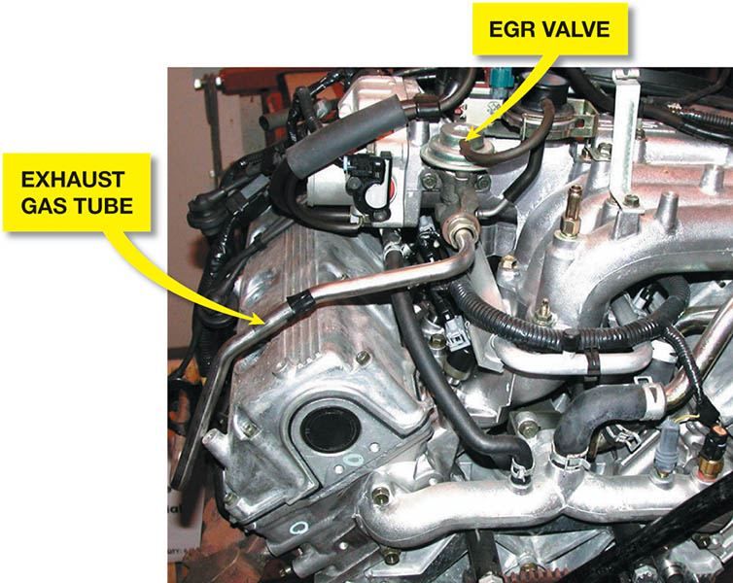
Figure 24.12 A typical long exhaust gas line used to cool the exhaust gases before being recirculated back into the intake manifold

Slide 30
EXHAUST MANIFOLDS (1 of 2)
The exhaust manifold is designed to collect high-temperature spent gases from the individual head exhaust ports and directs them into a single outlet connected to the exhaust system.
Most exhaust manifolds are made from the following:
Cast Iron
Steel Tubing

Slide 31
Exhaust Manifolds (2 of 2)
Many exhaust manifolds have heat shields to help keep exhaust heat off the spark plug wires and to help keep the heat from escaping to improve exhaust emissions.
The exhaust system length, pipe size, and silencer are designed, where possible, to make use of the tuning effect within the exhaust system.

Slide 32
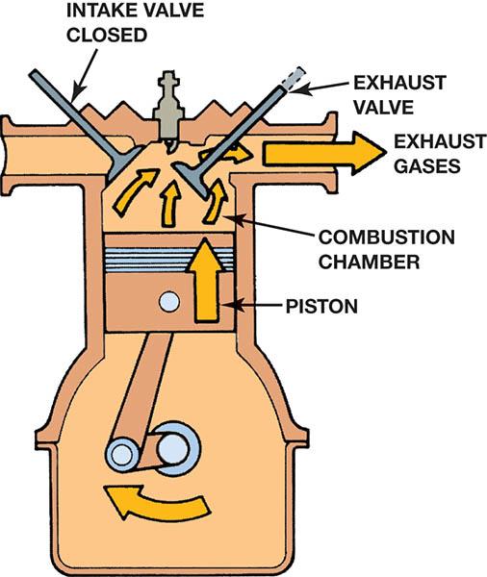
Figure 24.13 The exhaust gases are pushed out of the cylinder by the piston on the exhaust stroke

Slide 33
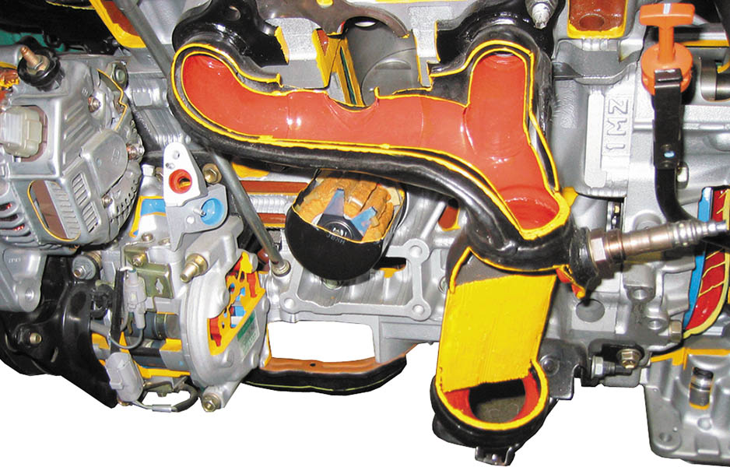
Figure 24.14 This exhaust manifold (red area) is equipped with a heat shield to help retain heat and reduce exhaust emissions

Slide 34
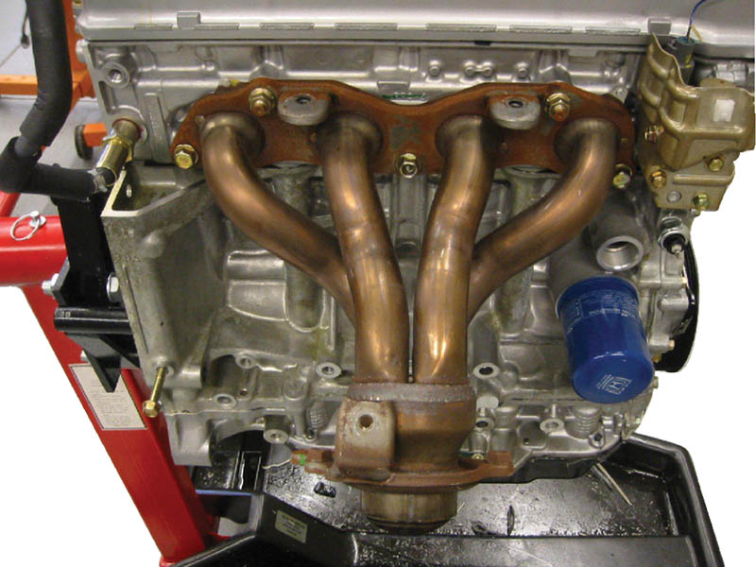
Figure 24.15 Many exhaust manifolds are constructed of steel tubing and are free flowing to improve engine performance

Slide 35
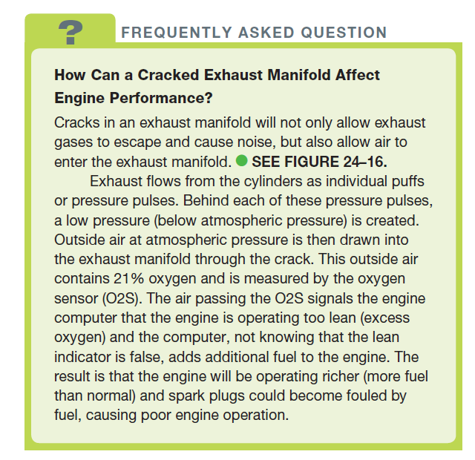
FREQUENTLY ASKED QUESTION

Slide 36
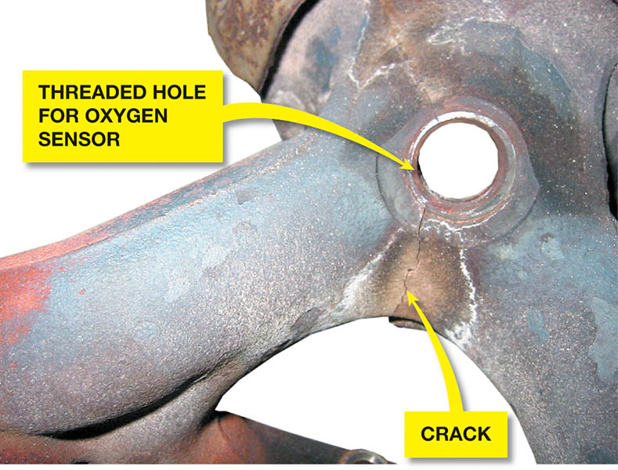
Figure 24.16 A crack in an exhaust manifold is often not visible because a heat shield usually covers the area. A crack in the exhaust manifold upstream of the oxygen sensor can fool the sensor and affect engine operation

Slide 37
EXHAUST MANIFOLD GASKETS
Exhaust manifold gaskets are used to seal slightly warped exhaust manifolds.
Engine may not have exhaust manifold gaskets when new.
Multi-layer, high-temperature gaskets are common on header style manifolds.

Slide 38
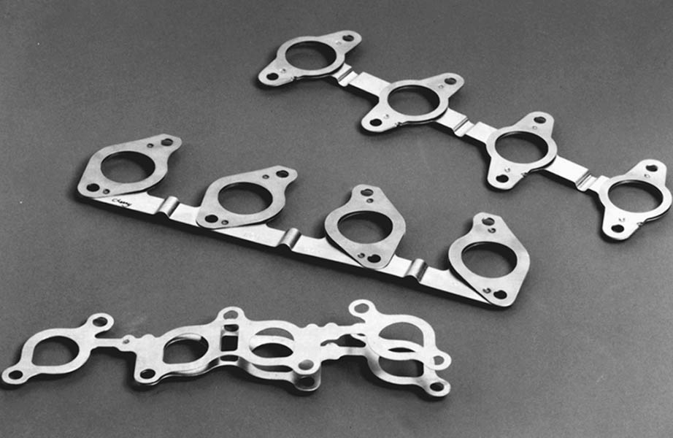
Figure 24.17 Typical exhaust manifold gaskets. Note how they are laminated to allow the exhaust manifold to expand and contract due to heating and cooling

Slide 39
TECH TIP

Slide 40
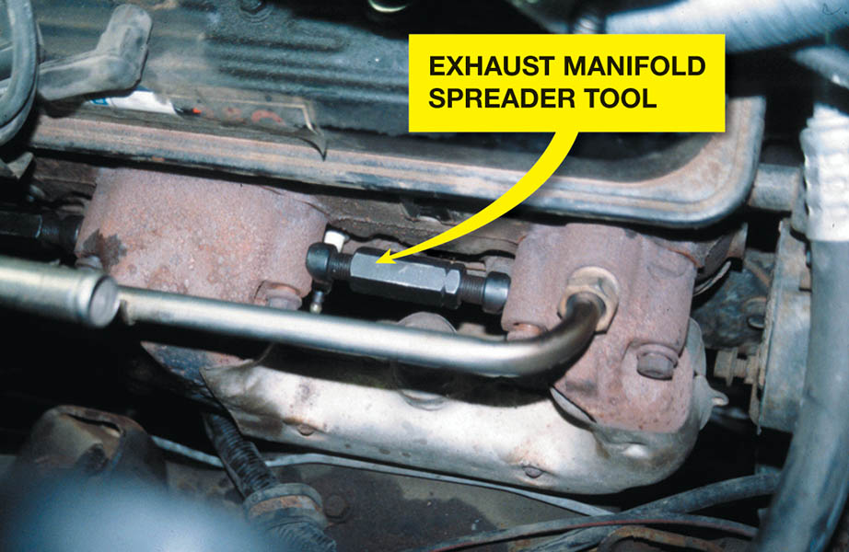
Figure 24.18 An exhaust manifold spreader tool

Slide 41
EXHAUST SYSTEM COMPONENTS
Catalytic Converter: Used to reduce harmful tailpipe emissions.
Exhaust Pipe: Conduct hot exhaust gases to the rear of the vehicle.
Heat Shields and Hangers: Prevent unwanted heat from moving upwards and isolate exhaust noise and vibrations from the passenger compartment.

Slide 42
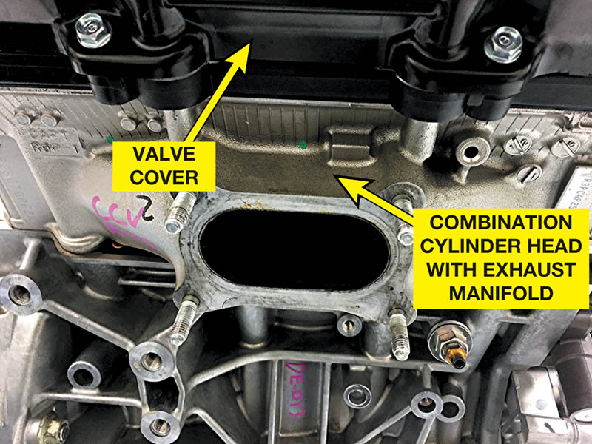
Figure 24.19 The “exhaust manifold” on this Honda is actually part of the cylinder head and not a separate part. The catalytic converter is attached directly to the cylinder head using four studs

Slide 43
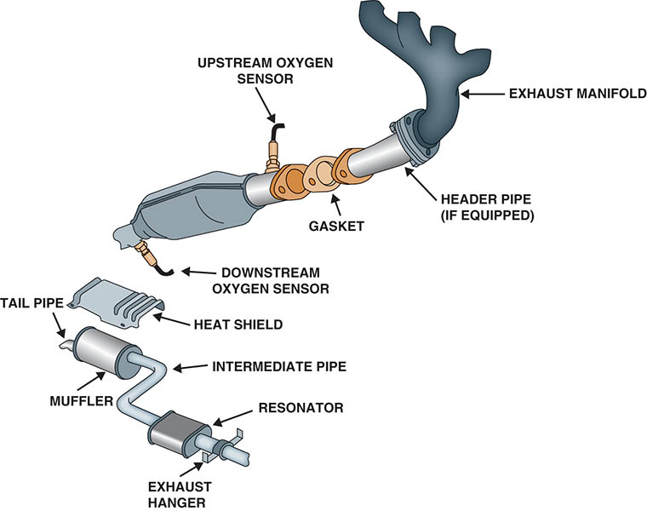
Figure 24.20 A typical exhaust system showing the heat shields and hangers used to isolate exhaust system vibrations from the vehicle body, and to control the movement as the exhaust system changes in length due to heat

Slide 44
MUFFLER
The muffler catches the large bursts of high-pressure exhaust gas from the cylinder, smoothing out the pressure pulses and allowing them to be released at an even and constant rate.
As the exhaust enters the muffler, it expands and cools.
The tailpipe carries the exhaust gases from the muffler to the air, away from the vehicle.

Slide 45
Figure 24.21 Exhaust gases expand and cool as they travel through passages in the muffler

Slide 46
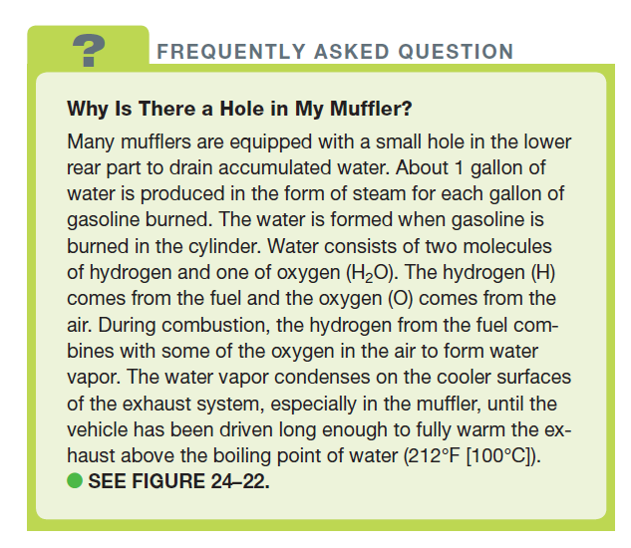
FREQUENTLY ASKED QUESTION

Slide 47
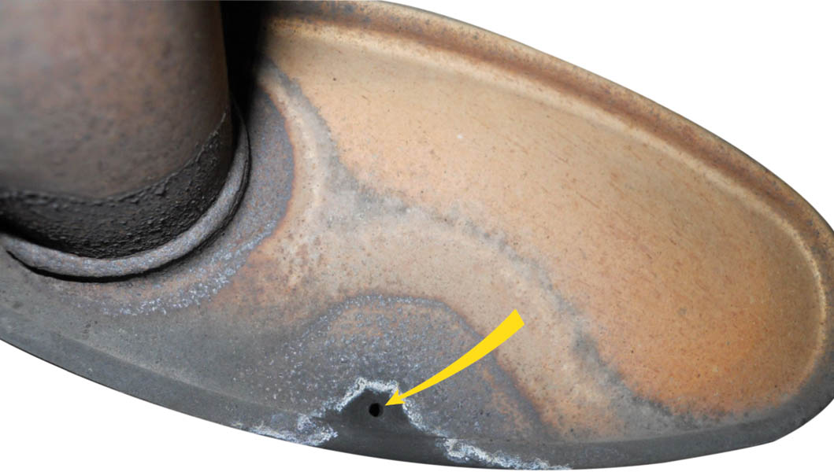
Figure 24.22 A hole in the muffler allows condensed water to escape

Slide 48
QUESTION 3: ?
What is the purpose and function of exhaust system hangers?

Slide 49
ANSWER 3:
Isolate exhaust noise and vibrations from the passenger compartment.

Slide 50
Copyright

