Slide 1
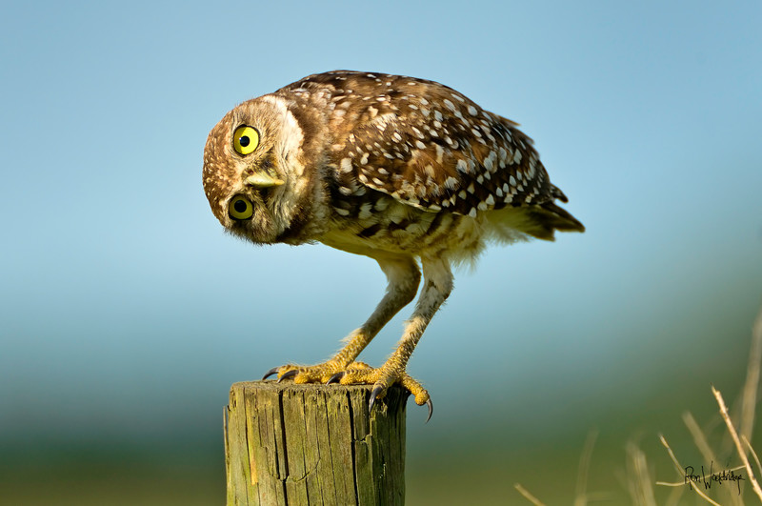
1.What is curiosity?
2.How can curiosity help you learn?

Slide 2
Mindful Monday
Write three questions about the topic assigned that you are truely interested in answering. You have 10 minutes to research your answers.

Slide 3
Topics:
Topic 1: your choice
Topic 2: people
Topic 3: animals
Topic 4: countries
Topic 5: sports
Topic 6: machines

