Slide 1
What is a function?
Function: a relation between a given set of elements, such that for each element in the domain there exists exactly one element in the range.

Slide 2
What is a function?
In math, a function is usually where we are “doing something” to a number.
Let’s say we are going to “double” everything, that is a function.
You could write that as: y = 2x
“x” is all of the numbers that a person could pick. “y” is all the answers.

Slide 3
How do you write that?
“x” is the input value, because it represents the numbers we are “putting in”.
“y” is the output value, because it represents the numbers that are “coming out”.
All of the numbers you can put in are called the domain.
All of the possible answers are called the range.

Slide 4
For example
Let’s say we pick “4”. Our function is to double that, so when we double 4 we get 8.
The input value is 4. That is part of the domain.
The output value is 8. That is part of the range.

Slide 5
Functions
So what if we had a domain of {0,1,2,3}?
If you put each value in to y = 2x, each answer would be an answer in the range.
Try that. What is the range?
The range is {0,2,4,6}
So let’s look at some characteristics of a function.

Slide 6
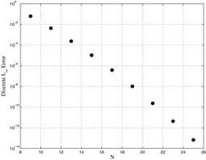
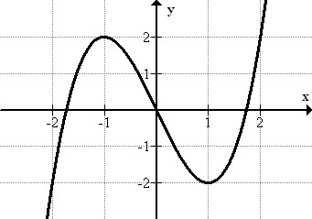
Discrete or Continuous?
Discrete
Things you count
Continuous
Things you measure

Slide 7
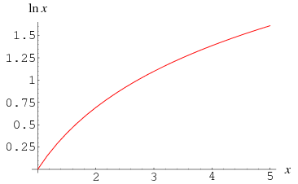
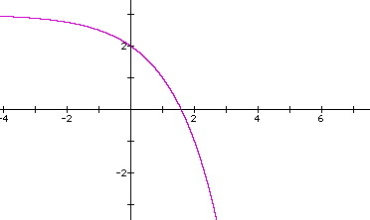
Increasing or Decreasing?
Increasing
Decreasing

Slide 8
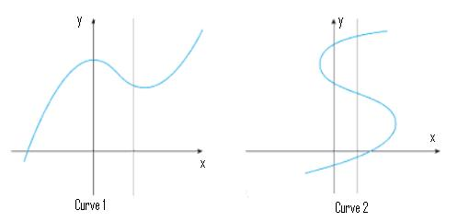
Vertical Line Test
Function
Not a Function

Slide 9
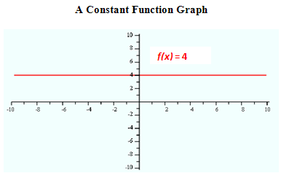
Oh, yeah … one more

Slide 10
Ok … actual last slide
“x” values
“y” values
Input
Domain
Independent
Output
Range
Dependent

Slide 11
Are we done now?

