Slide 1
Shanghai
By Liu Lao Shi

Slide 2
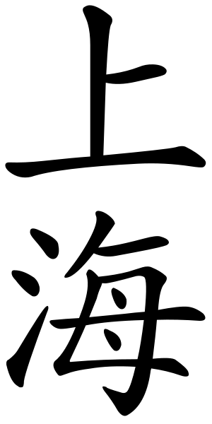
Shàng
Up, above, or On
Haǐ
The Ocean
Notes:
Shan means (read slide) and hai means (read slide). It is called this because it is right next to the ocean.

Slide 3
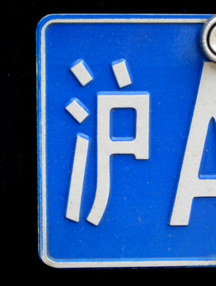
沪
Hù
Notes:
Hu is a common nickname for Shanghai, and can be found on all modern Shanghainese license plates.

Slide 4
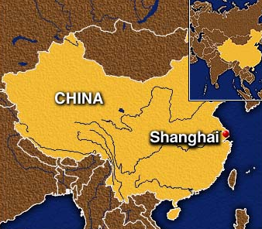
Hangzhou Bay
Yangtze
Notes:
The Shanghai province is located on a peninsula between the Yangtze river and the Hangzhou bay. It is a total of 6218km^2

Slide 5
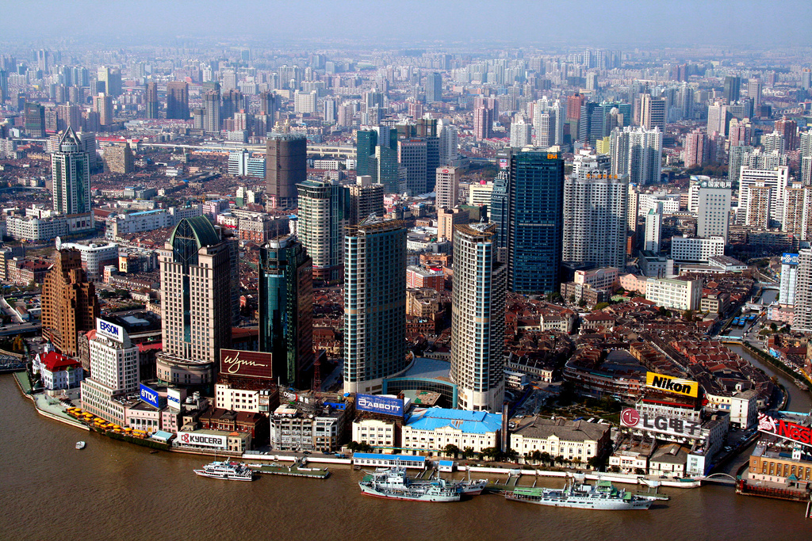
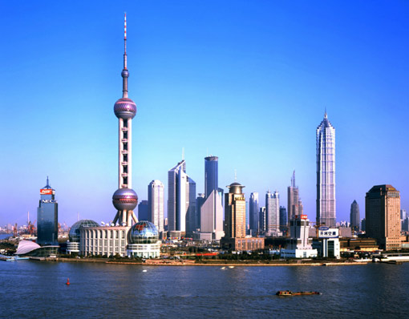
Notes:
In Shanghai, air pollution is low compared to other chinese cities, like beijing, but it is still high by worldwide standards (about equal to Beijing). Weather in Shanghai is relatively mild, with the average annual high being 68°F and the average low being 55°F.
Shanghai gets about 45.85in of rain a year, with the rainiest month being June, with an average of 6.68in annually.

Slide 6
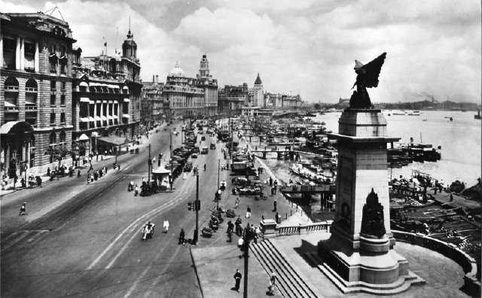
The Bund, 1930s
Notes:
Shanghai was founded in the 10th century. It was a small town until it became a cotton production and manufacturing center. This new industry quickly made it one of China’s most prosperous regions by the 13th century. After the Sino Japanese War, Japan occupied Shanghai and built the first modern factories there. This is a picture of the famous section of Shanghai called the Bund in the 1930s. It shows the Goddess of Peace monument which was erected in 1924 to celebrate the end of WWI. Unfortunately, it was destroyed during the Japanese occupation.

Slide 7
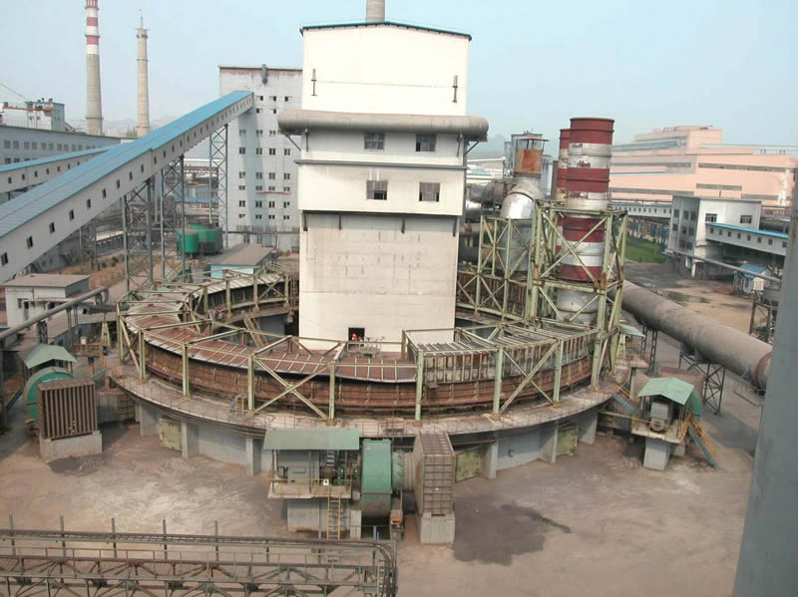
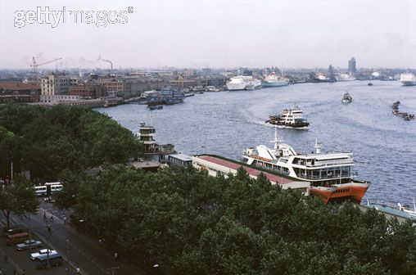
Notes:
Shanghai is China’s largest city and largest seaport. It is also the biggest industrial center in China. Industries include Industries include metallurgy, chemicals, petroleum, machinery, automobiles, electronics, shipbuilding, light industry, textiles, electrical appliances.
This is a Shanghai metallurgy center.

Slide 8
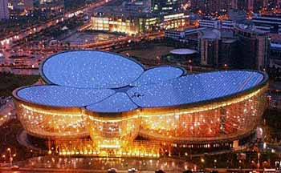
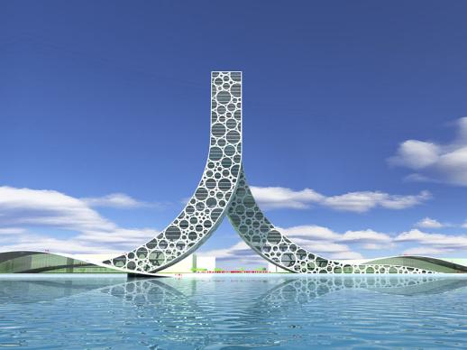
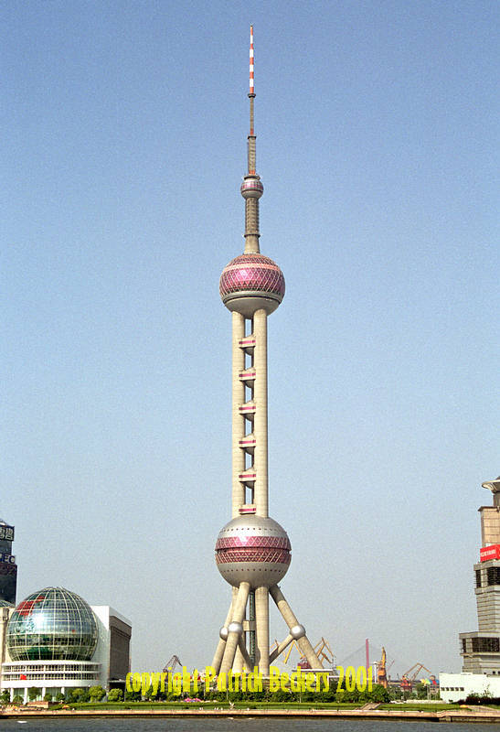
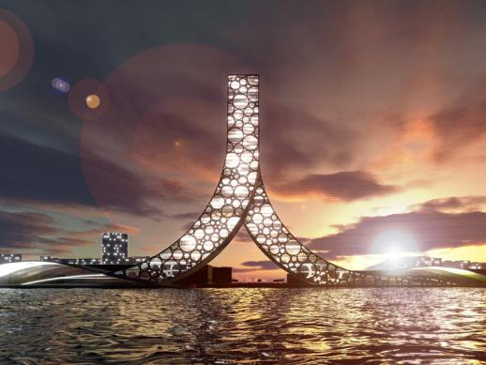
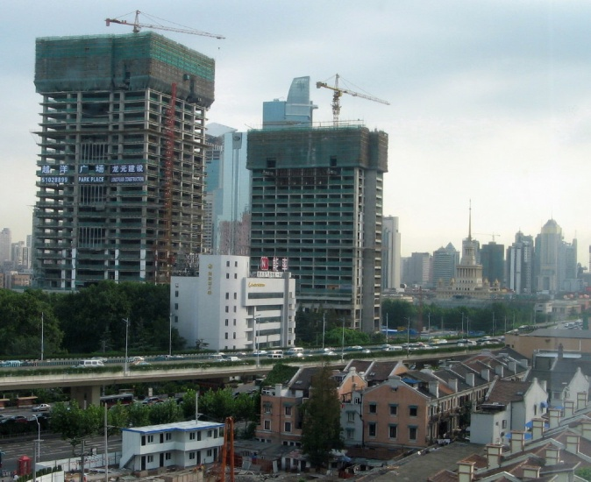
The People’s Building
Oriental Art Center
Oriental Pearl TV Tower
Notes:
Shanghai is undergoing continuous construction and expansion, especially because the world expo will be held there in 2010. Shanghai has a very unusual and unique modern architectural style. This is an example of Shanghai’s modern architecture: the People’s building. It was built for the 2010 Expo which will be held in Shanghai. It is called the People’s building because its shape is representative of the Chinese character for ‘person’. At the top, where the two legs intersect, is a 1000 room hotel, and floating on the water underneath the intersection is a wide grass field where people can enjoy the view of Shanghai. The other building is the Oriental Pearl TV Tower.

Slide 9
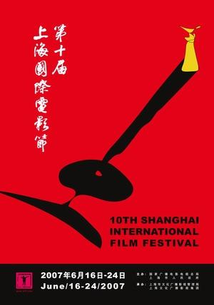
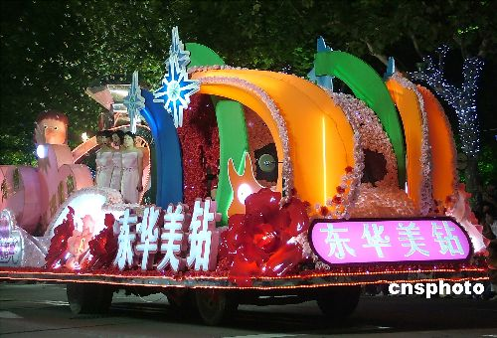
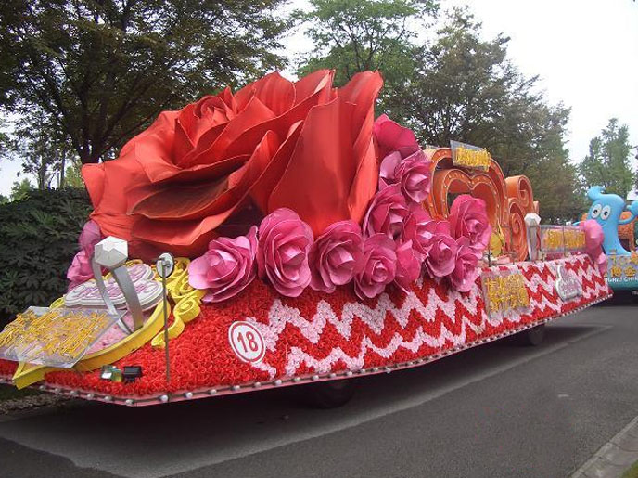
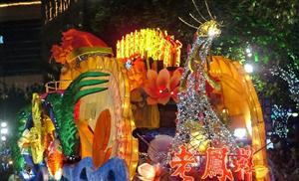
Notes:
The Shanghai Film Festival began in 1993, and has been held every year. The Shanghai tourism festival is held every year from the third Saturday of september to the 16th of October. It’s a celebration of Shanghainese and Chinese culture.

Slide 10
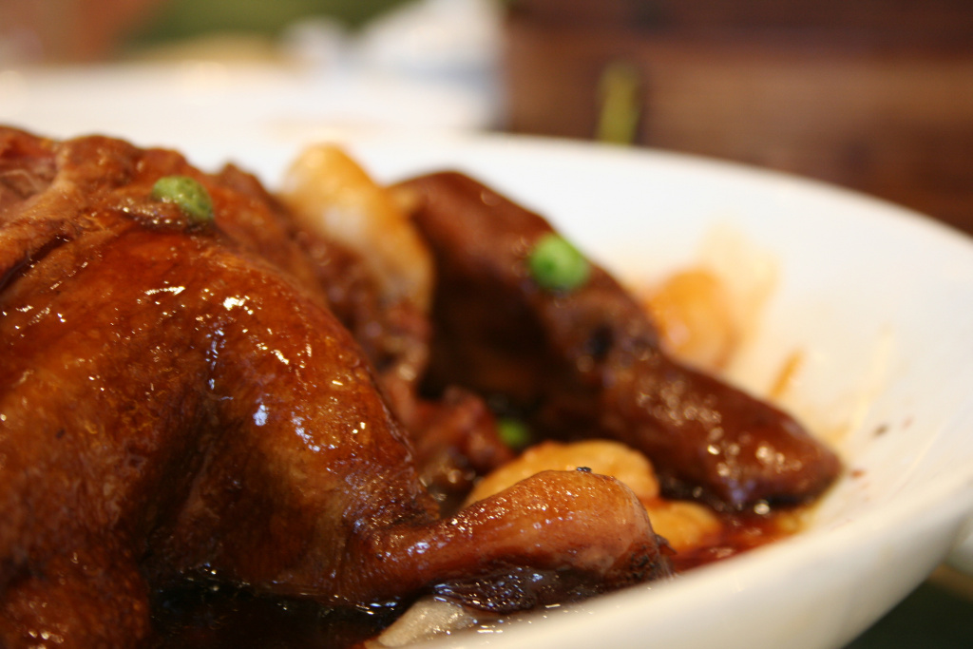
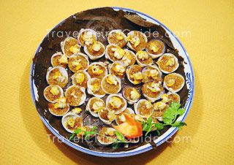
Benbang Cuisine
Haipai Cuisine
Notes:
Benbang-literally means ‘local cuisine’, traditional family cuisine began 100 years ago. Fresh fish, chicken, pork, and various vegetables. Haipai-derived from cuisines from all around the world that meet in Shanghai. Absorbs many cuisines, including western cuisines, and adapts them to local tastes.

Slide 11
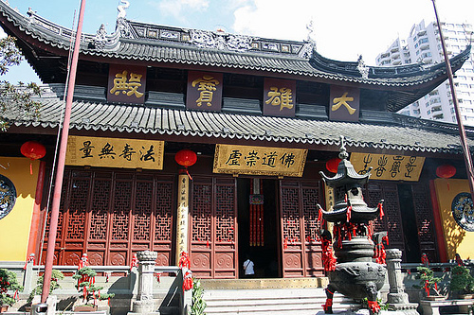
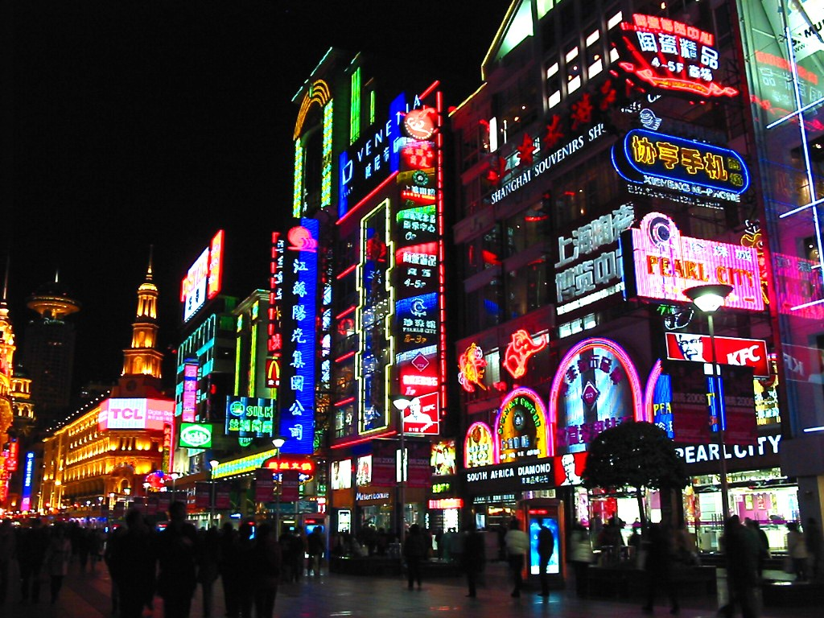
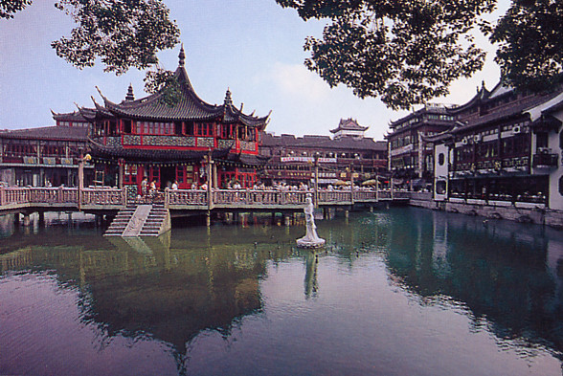
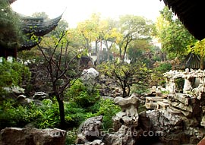
Notes:
Among the various tourist attractions in Shanghai is the Jade Buddha Temple. Tourists can also visit the Yuyuan Gardens. The Yuyuan gardens span 20,000 sq mi. It was laid out in 1559. It was originally built by a burmese monk in 1882, but it was destroyed in 1911 due to the revolution. It was rebuilt in 1928. Shanghai is also famous for its shopping. The famous Nanjing Road is the no. 1 commercial street in China.

Slide 12
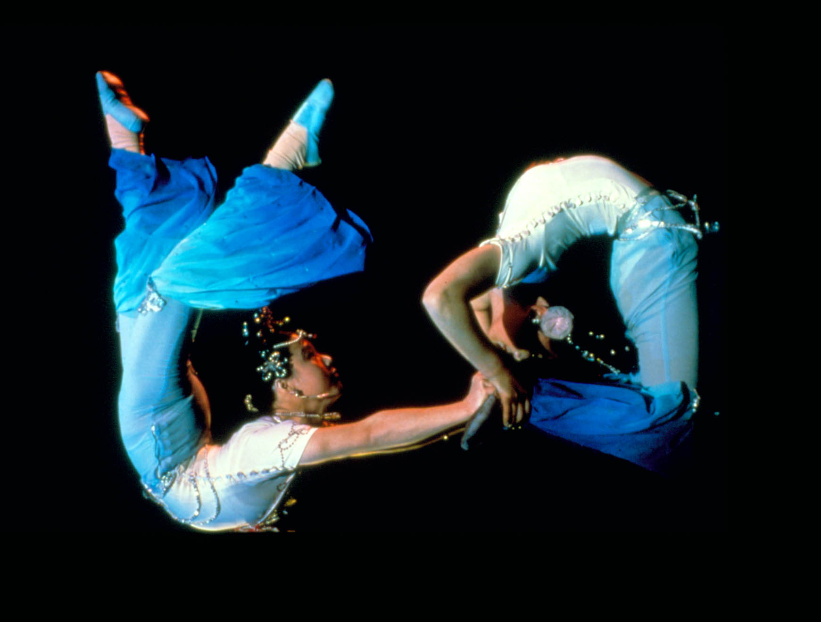
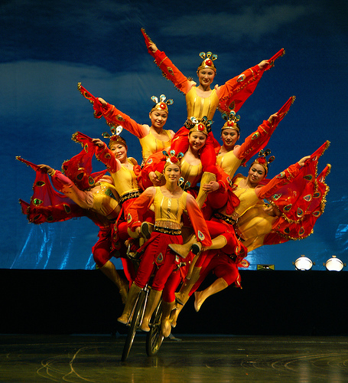
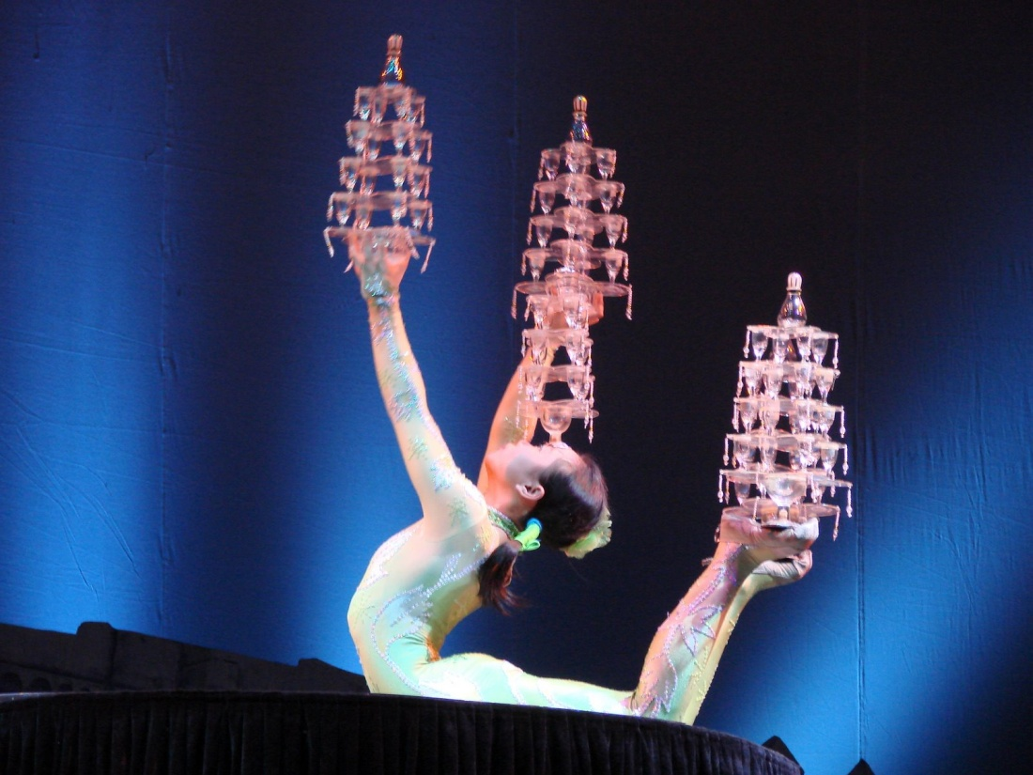
Notes:
Shanghai is world famous for its acrobatic shows. Acrobatics first appeared in china during the Han dynasty. Everday people would practice acrobatics to improve their social standing. They would use any materials available to them-plates, hoops, chairs, etc.

Slide 13
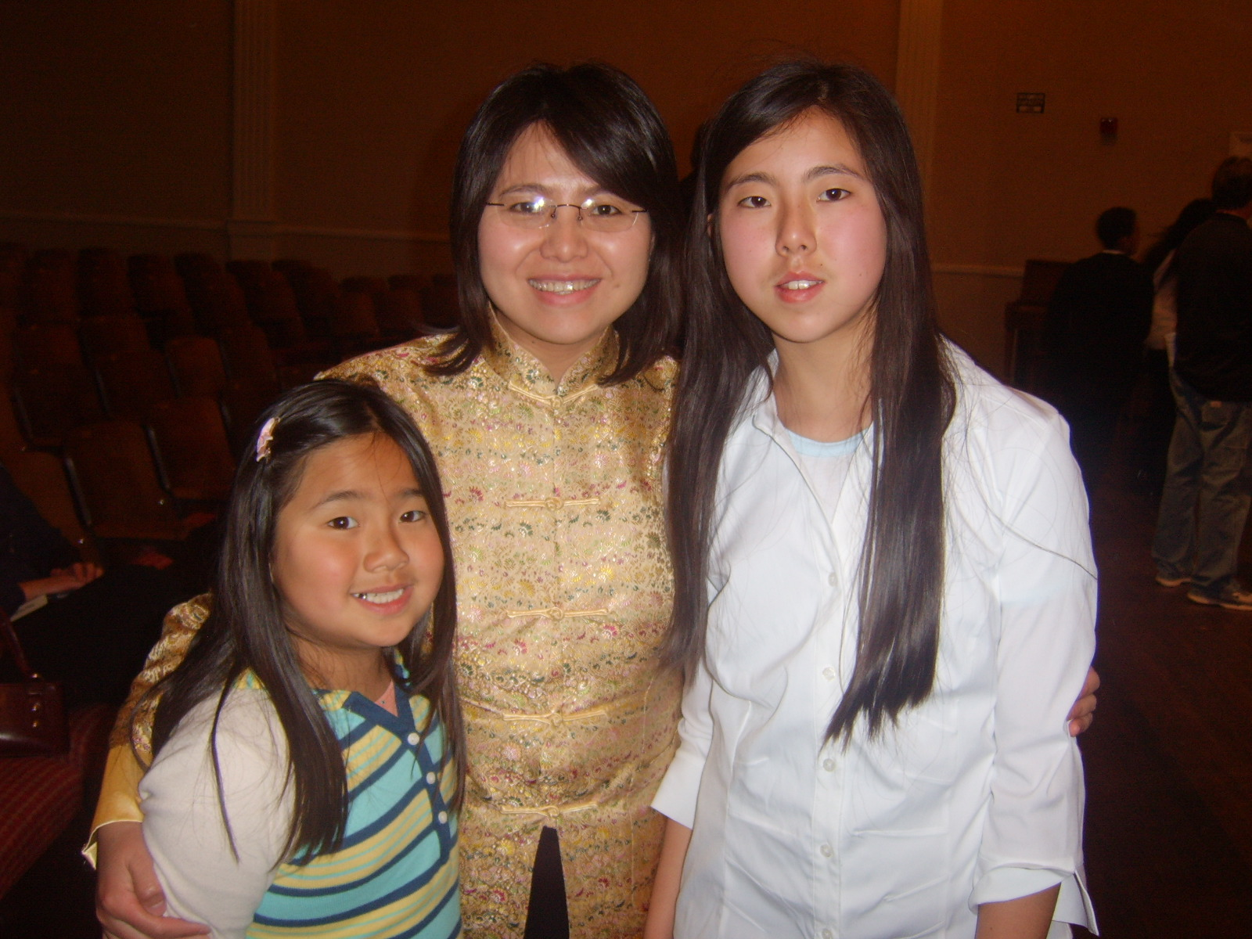
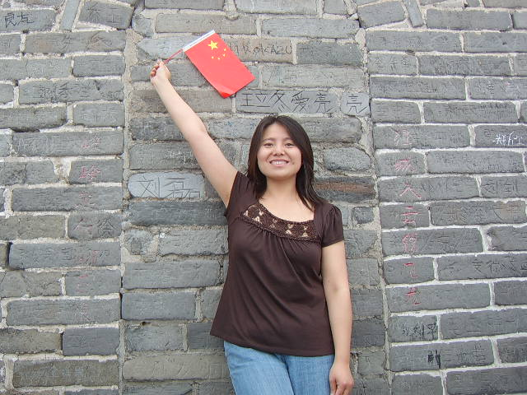
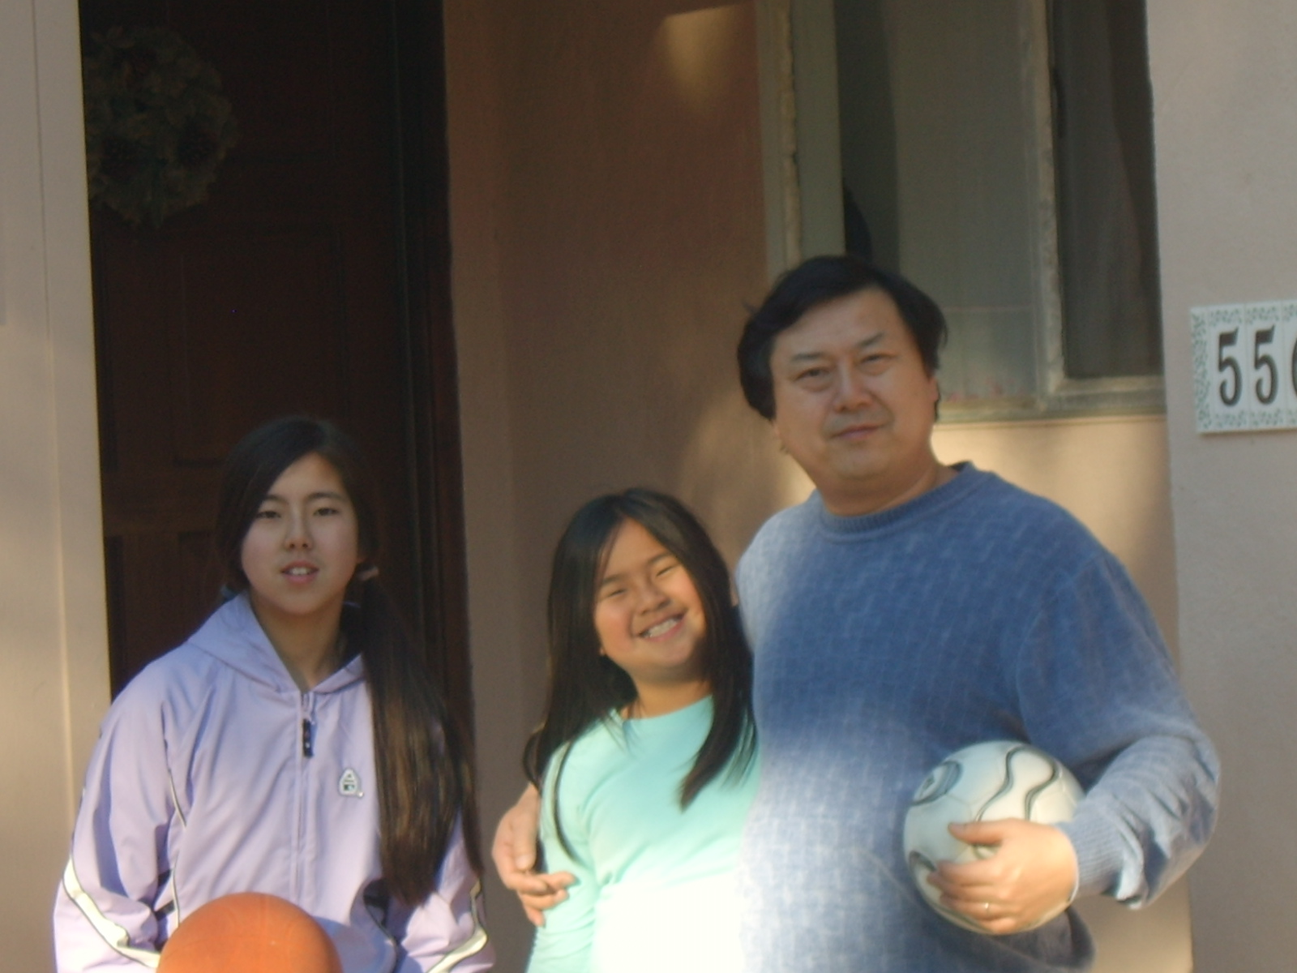
Liu Lao Shi

Slide 14
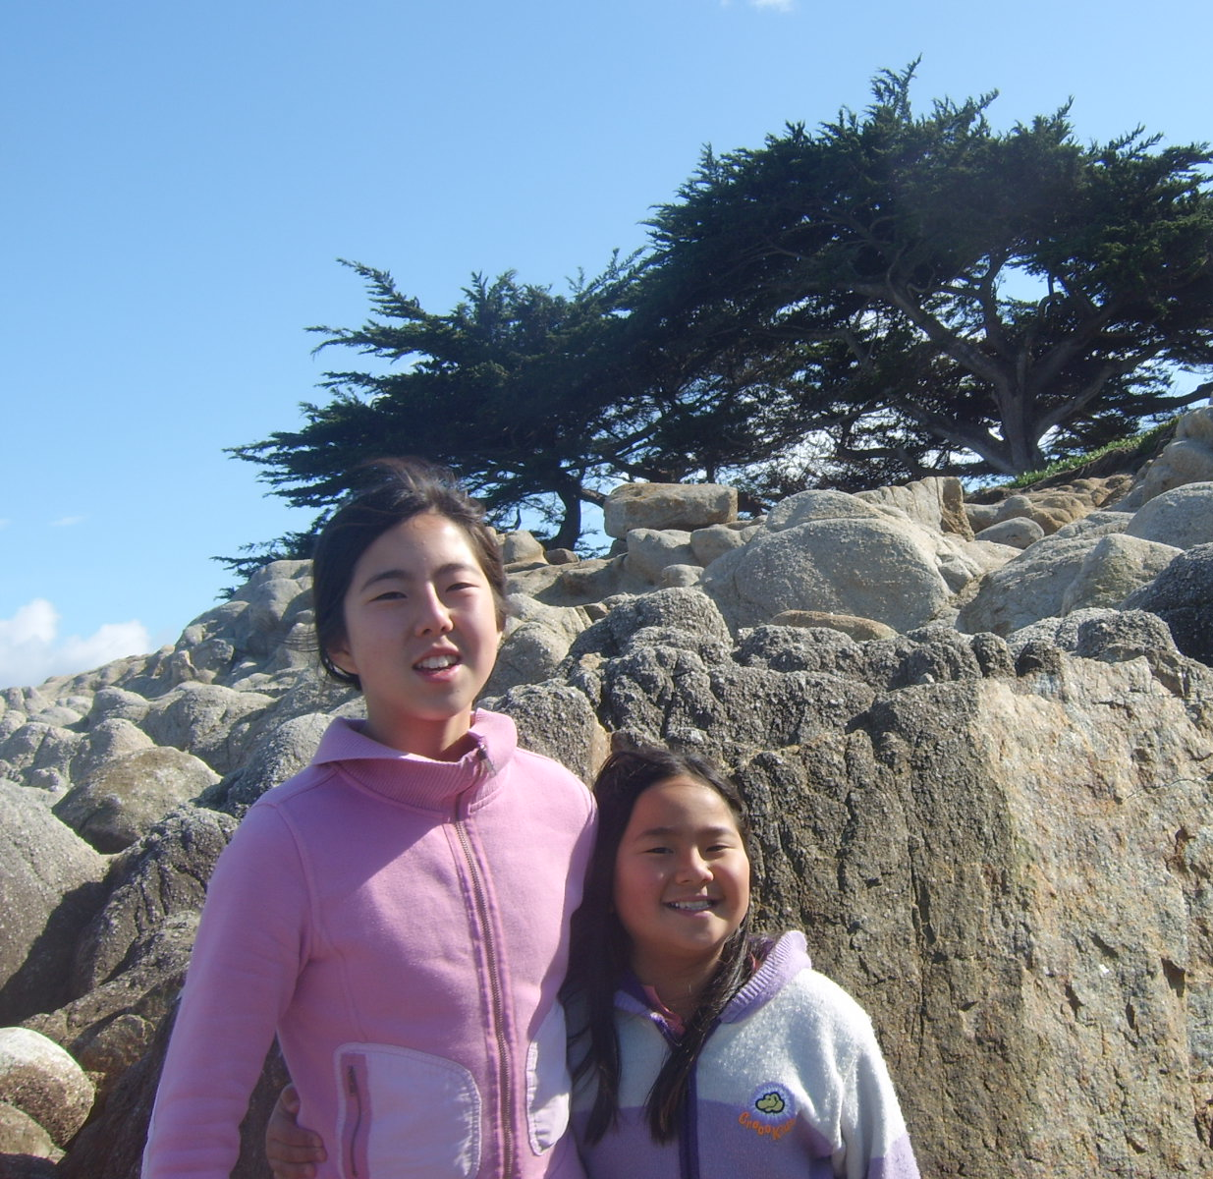
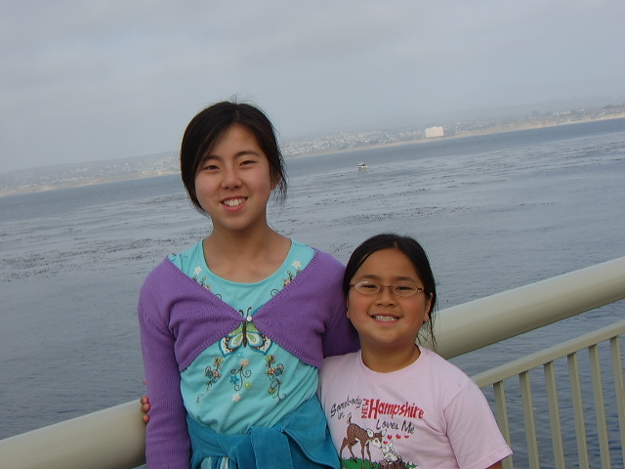
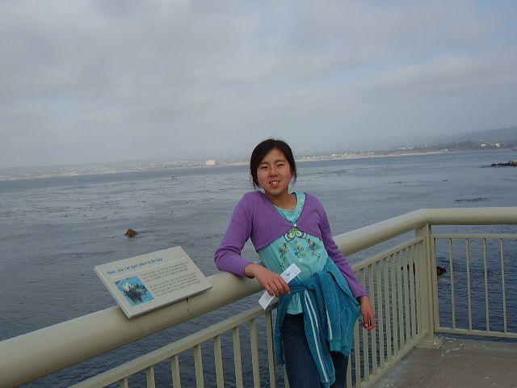
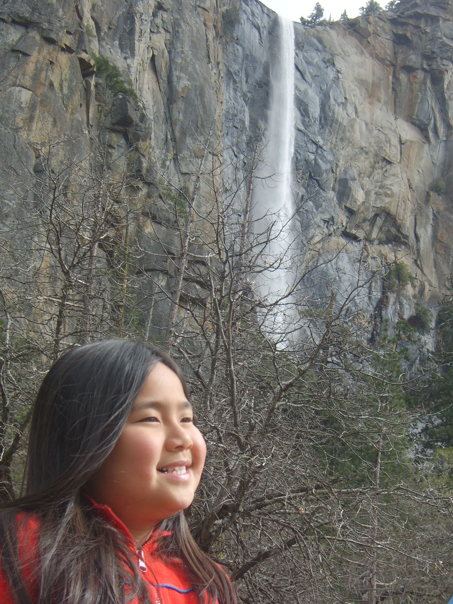
My Family
Grace
Melody
Grace

Slide 15
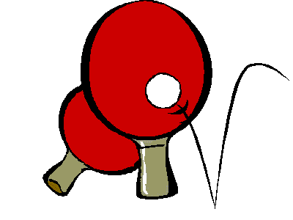
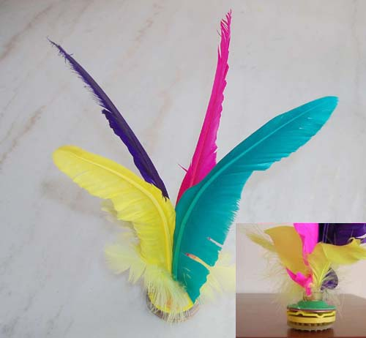
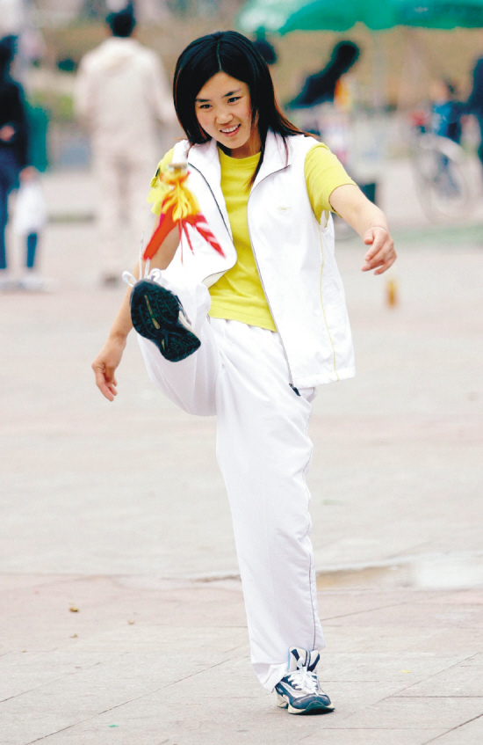
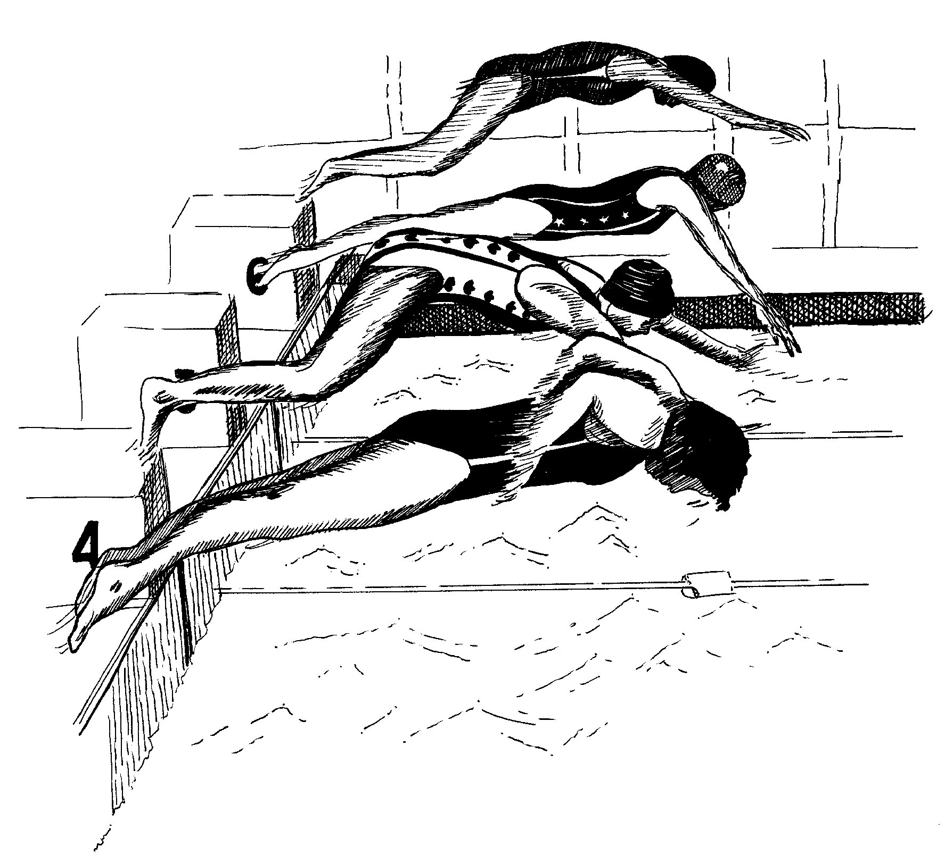
My Hobbies

