Slide 1
Linear Functions Review

Slide 2
Ummm …. What?

Slide 3
Is it a function?
Other types of functions besides linear:
-Exponential: y = $2^{x}$
-Quadratic: y = x²
Regardless, all functions must:
a. have a one to one relationship
b. Must pass the vertical line test

Slide 4
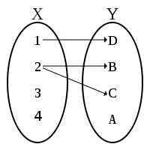
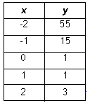
One to One Relationship
1 to 1 relationship
Not so much

Slide 5
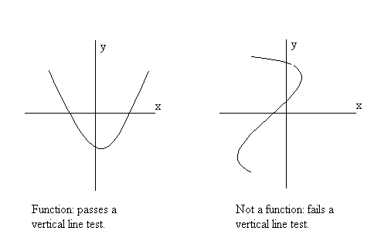
Vertical Line Test

Slide 6
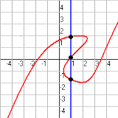
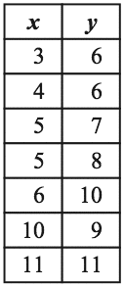
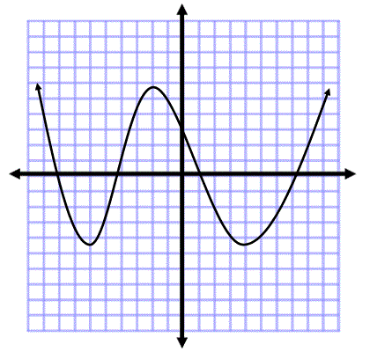
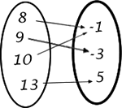
Which are functions?

Slide 7
The Parts of a Linear Function
When graphed, all sets of points form a line.
Domain: all values of x
Range: all values of y
Slope (also known as Rate of Change): denoted as “m”. It is the constant rate at which the line changes.
Y-intercept: denoted as “b”.

Slide 8
Slope-Intercept Form: y=mx+b
m is the slope and b is the y-intercept
So in y = 2x – 7 What is slope? Y-intercept?
The slope is 2 because y = 2x – 7
The y-intercept is -7, because y = 2x – 7

Slide 9
You Try (find “m” and “b”)
y = 3x + 4
y = 8 – 4x
y = ¾x
y = x – 9
y = - 4
-3x + y = 9

Slide 10
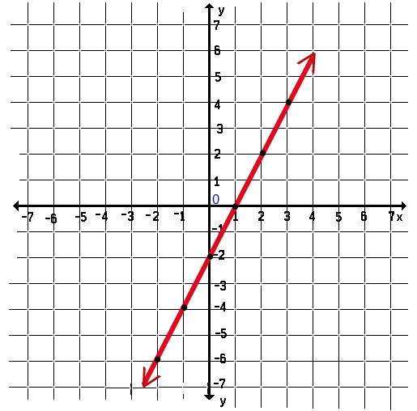
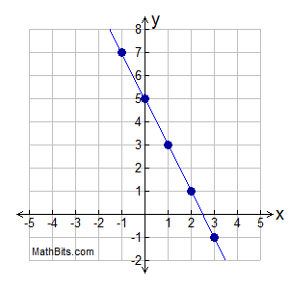
Write the Equation of Each Line
y = -2x + 5
y = 2x - 2

Slide 11
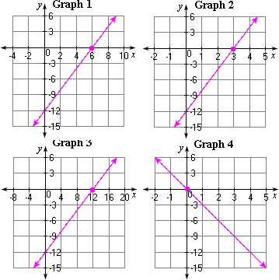
Now try these. Look carefully at the scale!

Slide 12
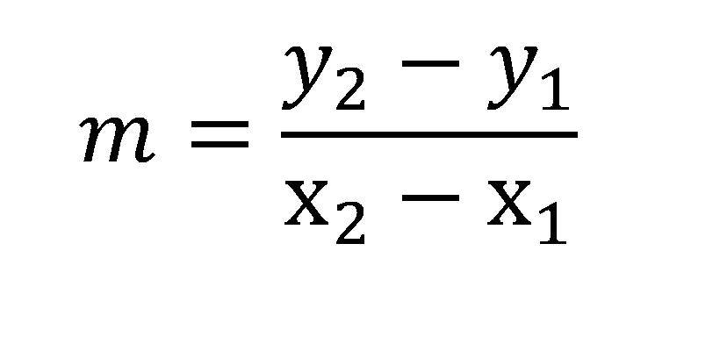
Slope: No Graph? No Problem.
You can find the slope by using two points.
Ex. (-4,1) and (3, 6)
$\frac{6 −1}{3 −(−4)}$ = $\frac{5}{7}$

Slide 13


Last Slide: Find the Slope
(4, -3) and (2, -1)
(0, -5) and (7, 2)
$\frac{−1 −(−3)}{2 −4}$
$\frac{−1+3}{−2}$
$\frac{2}{−2}$ = -1
$\frac{2 −(−5)}{7 −0}$
$\frac{2+5}{7}$ = $\frac{7}{7}$ = 1

