Slide 1
VERBS LIKE GUSTAR

Slide 2
Los básicos
To express like or dislike in Spanish we use GUSTAR.
GUSTAR works differently than other verbs because the conjugation agrees with what you like, not who likes it.
Since items and actions are either singular or plural, most of the time GUSTAR will take the ÉL or ELLOS form.
GUSTAR also requires an Indirect Object Pronoun in front of the verb

Slide 3
LOS PRONOMBRES
ME (to me) | NOS (to us)
TE (to you) | OS (to you all)
LE (To him, her, you) | LES (to them)

Slide 4
Choose your pronoun
The pronoun will match to the person or thing that “likes” the item or action.
The verb will match to whatever it is they like. If its plural use GUSTAN. If it’s a single item or an action (verb) use GUSTA.
Vamos a mirar un ejemplo…

Slide 5
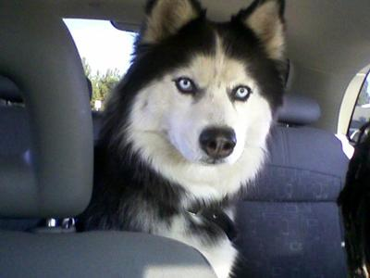
Jorge likes cars.
When we express this thought in Spanish, its really more like “the cars please Jorge.”
Cars (los carros) are plural, so we will use the plural conjugation of GUSTAR.
→ GUSTAN LOS CARROS

Slide 6
Jorge ____ gustan los carros.
Now we need a pronoun. Jorge is one guy, so the best choice would be…
LE
We’re almost done, but there is one more thing you need to know…

Slide 7
Clarifiers
Spanish uses clarifiers for emphasis or clarification. Most importantly when the subject of the sentence is in the 3rd person. (EL, ELLOS)
Clarifiers include: a mí, a tí, a él/ella, a Ud., a nosotros, a vosotros, a ellos, a ellas, a Uds.
A Jorge le gustan los carros.
Jorge likes cars! No doubt!

Slide 8
CLARIFIERS
Clarifiers aren’t limited to the 3rd person.
There are clarifiers for all pronouns. Mostly clarifiers get used in the 3rd person, because it’s the one that is least clear. (Imagine that!)
A mí me gustan los tacos. → Me, I like tacos.
Sometimes Spanish speakers stick them on just for emphasis.

Slide 9
Clarifiers
A mí | A nosotros
A tí | A vosotros
A él A ella A Ud. | A ellos A ellas A Uds.

Slide 10
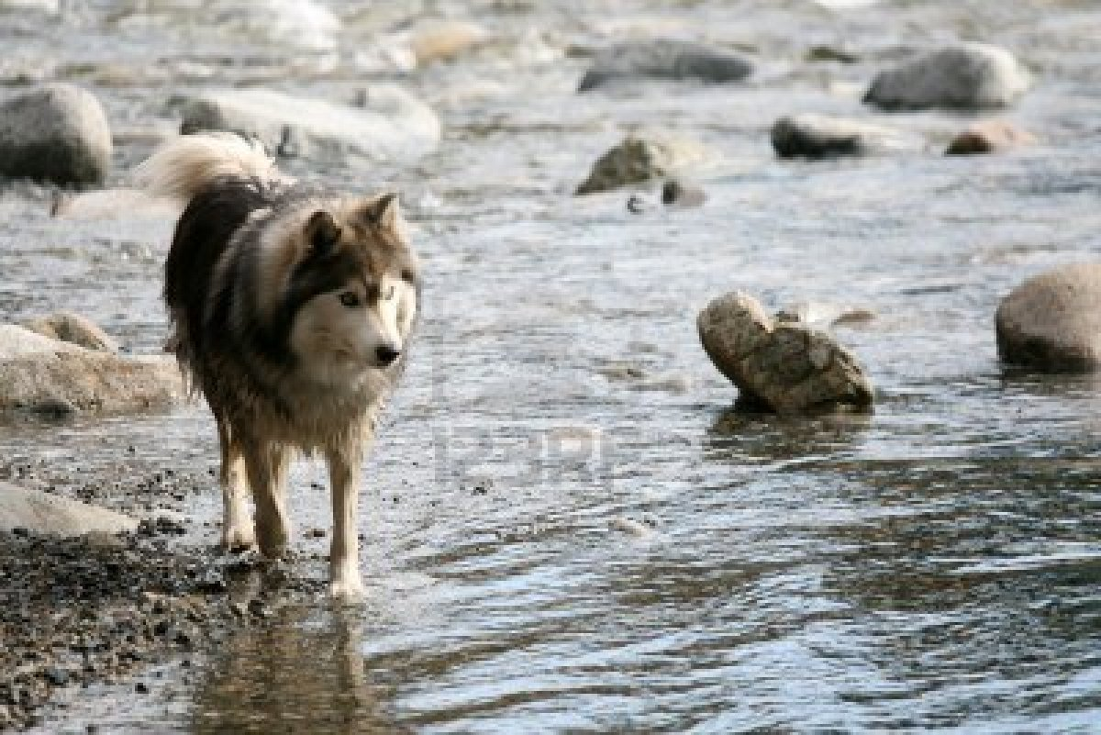
Practiquemos…
Paco likes to swim.
Swimming is an action, so you will use the singular form of GUSTAR.
Try to put the sentence together now…
A Paco le gusta nadar.
If Paco enjoyed more than one action, use GUSTAN.

Slide 11
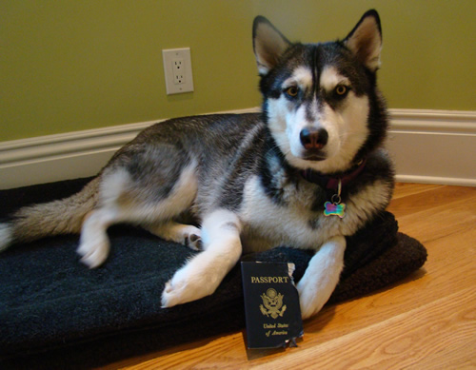
¡Uno más!
Diego likes to travel.
A Diego le gusta viajar.
What if Diego brought a friend?
How would the sentence change?

Slide 12
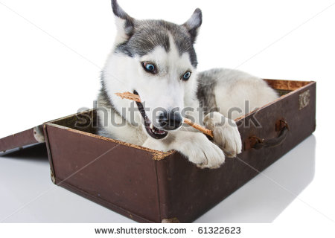
A Diego y Julio les gusta viajar.
Changing the le → les makes the sentence work for more than one person.
Diego brought a friend, but VIAJAR is still a single action.

Slide 13
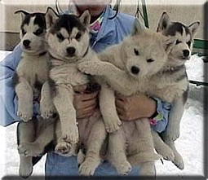
For plural items…
Switch up the GUSTA to GUSTAN.
Your pronoun choice still depends on who is pleased by the item or action.
I like Huskies. →
Me gustan los siberianos.
Huskies please me.

Slide 14
¡Practiquemos!
We like meat (la carne)
I like the park.
You like to run.
He likes to eat shoes.
He likes to walk.
We like to eat.
You all like to chase cats. (cazar los gatos)
Nos gusta la carne.
Me gusta el parque.
Te gusta correr.
Le gusta comer zapatos.
Le gusta caminar.
Nos gusta comer.
Os/les gusta cazar los gatos.

Slide 15
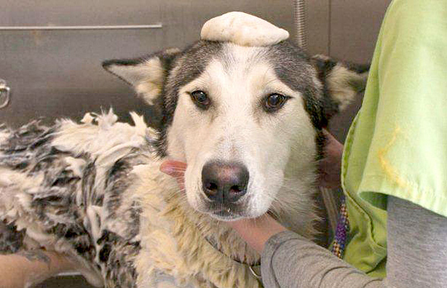
What if you don’t like it?
Just slide a “NO” between the person and the pronoun.
A Felix no le gustan los baños.
A Felix no le gusta el agua.
A Felix no le gusta el jabón.

Slide 16
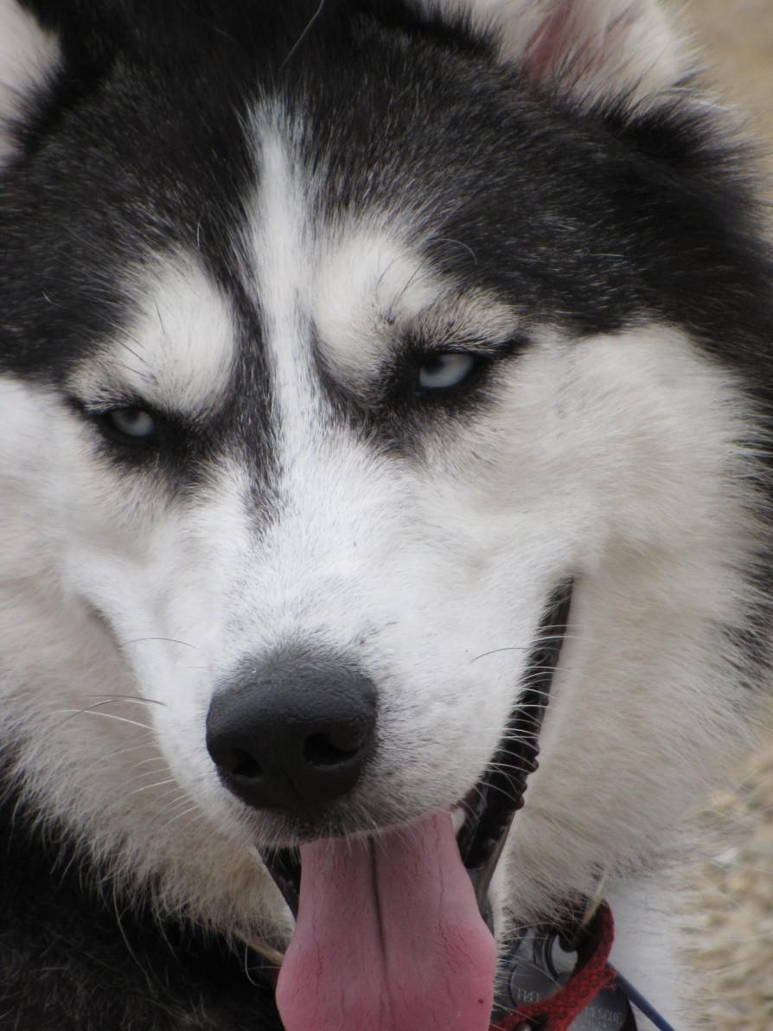
Try some negative sentences here:
We don’t like cats.
No nos gustan los gatos.
They don’t like to bathe.
No les gusta bañar.
I don’t like being alone. (estar sólo)
No me gusta estar sólo.

Slide 17
Other verbs like GUSTAR
ENCANTAR | To love (not romantic)
Interesar | To be interested by
Fascinar | To be fascinated by
Importar | To matter to
Molestar | To be bothered by
Fastidiar | To be irritated by , annoyed

Slide 18
Escribe en español.
Tests bother me.
Me molestan los examenes.
You love pizza.
Te encanta la pizza.
Good grades matter to us.
Nos importan las buenas notas.
They like to play soccer.
Les gusta jugar al futból.
I am interested in sports.
Me interesan los deportes.
Birds fascinate me.
Me fascinan los pájaros.

Slide 19
¿GUSTA or GUSTAN?
Which should you use with VERBS?
Which should you use with SINGLE NOUNS?
Which should you use with PLURAL NOUNS?
Which should you use with MORE THAN ONE NOUN?
Which would you use with MORE THAN ONE VERB? (ex: bailar y cantar)

Slide 20
Gusta or Gustan?
Me _________ leer libros.
Te __________ comer la fruta.
Nos __________ los perros.
Les __________ los zapatos rojos.
Le ___________ el chocolate y el helado.
Os ___________ estudiar con amigos.
Me ___________la ensalada.

Slide 21
Checa las respuestas
Me ____gusta_____ leer libros.
Te _____gusta_____ comer la fruta.
Nos ___gustan____ los perros.
Les ___gustan______ los zapatos rojos.
Le ____gustan____ el chocolate y el helado.
Os ____gusta____ estudiar con amigos.
Me ____gusta_____la ensalada.

Slide 22
Fill in the missing pronoun
A Paco ____ gusta ir a McDonalds.
A nosotros ____gusta bailar.
A mí ___ gustan las muchachas.
A tí ____ encanta el helado de vainilla.
A ellos ____ importan buenas notas.
A vosotros _____ molesta correr en la lluvia.
A ellas _____ importa el examen.

Slide 23
Checa las respuestas
A Paco __le__ gusta ir a McDonalds.
A nosotros _nos___gusta bailar.
A mí _me__ gustan las muchachas.
A tí _te___ encanta el helado de vainilla.
A ellos _les_ importan buenas notas.
A vosotros __os___ molesta correr en la lluvia.
A ellas __les___ importa el examen.

Slide 24
En un papel, contesta las preguntas
1. ¿Qué te gusta(n)? →
2. ¿Qué te gusta más? →
3. ¿Qué no te gusta nada? →
4. ¿Qué te molesta(n)? →
5. ¿Quién te importa(n)? →
6. ¿Qué te interesa(n)? →
7. ¿Qué te fascina(n)? →

Slide 25
Extra words for emphasis
Mucho → a lot
Mejor →better
Nada → not at all
Más → more
Menos → less
You can use these after GUSTA or any other like verb in the sentence.
EX: Me gusta mucho dormir.
EX: No me gusta nada limpiar la casa.

Slide 26
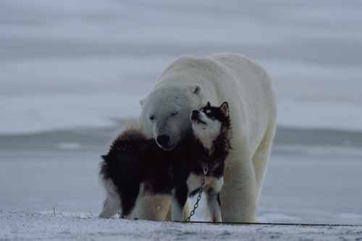
Actividad
Interview a classmate about what they like to do on the weekends.
Ask them at least 8 questions. Use GUSTAR or other like verbs. (molestar, encantar, etc)
Record their answers and then present them to the class.

