Slide 1
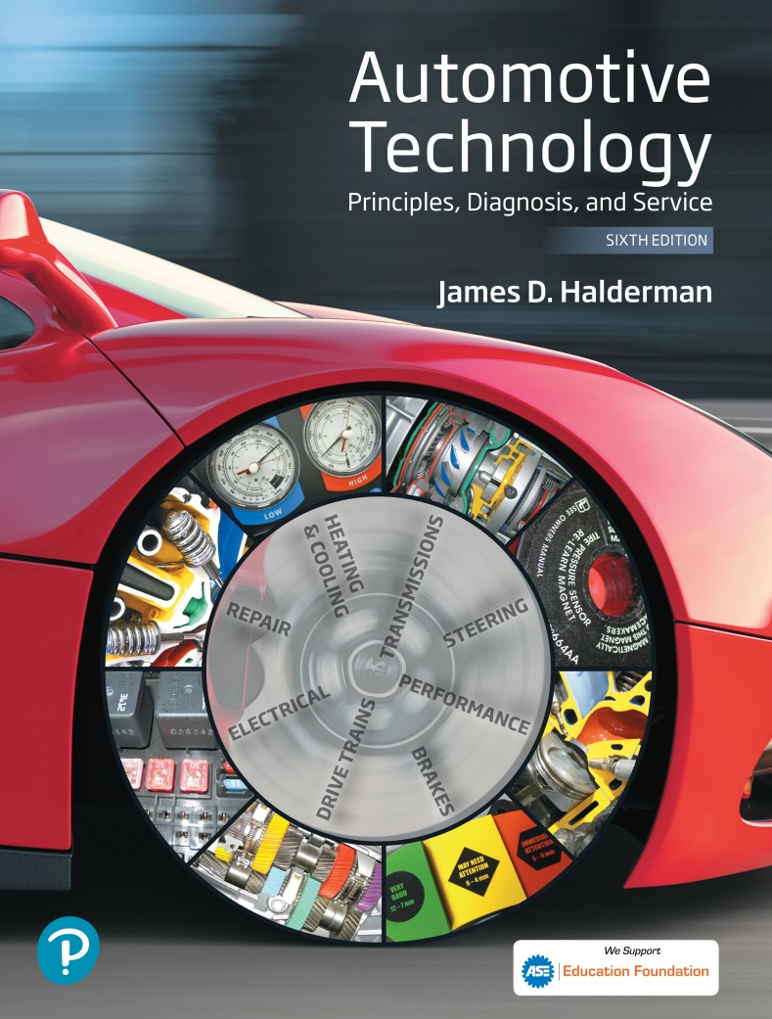
Automotive Technology Principles, Diagnosis, and Service
Sixth Edition
Chapter 18
Gasoline Engine Operation, Parts, and Specifications
Copyright © 2018, 2015, 2011 Pearson Education, Inc. All Rights Reserved

Slide 2
LEARNING OBJECTIVES (1 of 2)
18.1 Discuss engine construction, the engine’s purpose and function, energy and power, and engine construction.
18.2 Explain engine parts and systems.
18.3 Explain four-stroke cycle operation.

Slide 3
LEARNING OBJECTIVES (2 of 2)
18.4 Discuss engine classification and construction.
18.5 Explain engine measurement.
18.6 Discuss compression ratio, torque, and horsepower.

Slide 4
ENGINE PURPOSE AND FUNCTION, ENERY AND POWER
Convert heat energy of fuel into mechanical energy.
Propel the vehicle
Power the air-conditioning and power steering
Produce electrical power needed throughout the vehicle.
Internal Combustion: Occurs within the power (combustion) chamber.
Creates mechanical force which is converted to mechanical power.

Slide 5
ENGINE CONSTRUCTION OVERVIEW
Block: The solid frame constructed from cast iron or aluminum that provides the foundation for most systems.
Rotating Assembly: The crankshaft and the connecting rods and pistons.
Cylinder Heads: Seals the tops of the cylinder and contains the valves that allow the air/fuel into the cylider and the exhaust out of the cylinder.

Slide 6
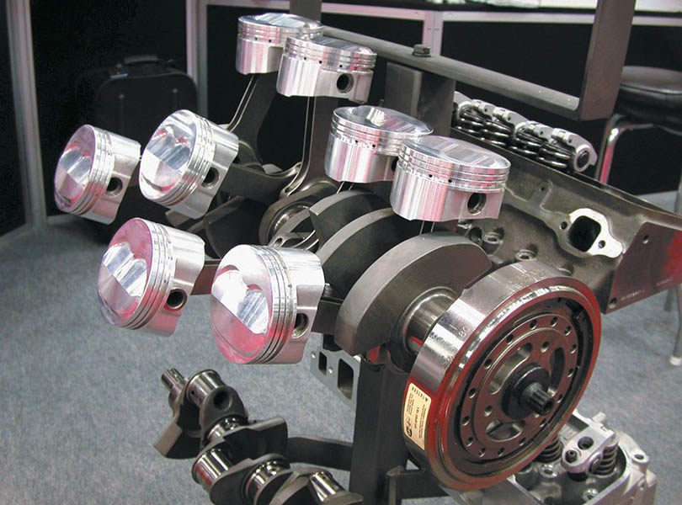
Figure 18.1 The rotating assembly for a V-8 engine that has eight pistons and connecting rods and one crankshaft.

Slide 7
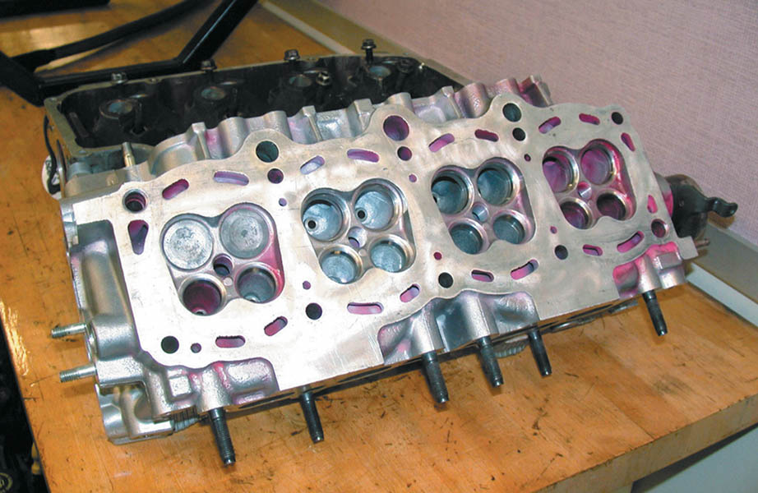
Figure 18.2 A cylinder head with four valves per cylinder, two intake valves (larger) and two exhaust valves (smaller)

Slide 8
ENGINE PARTS AND SYSTEMS
Intake and Exhaust System: Air enters the engine through the intake and exits through the exhaust.
Cooling System: Used to control engine temperatures.
Lubrication System: Used to lubricate moving and sliding components to reduce wear and dissipate heat.
Fuel and Ignition Systems: Provides the needed fuel and spark to the cylinder.

Slide 9
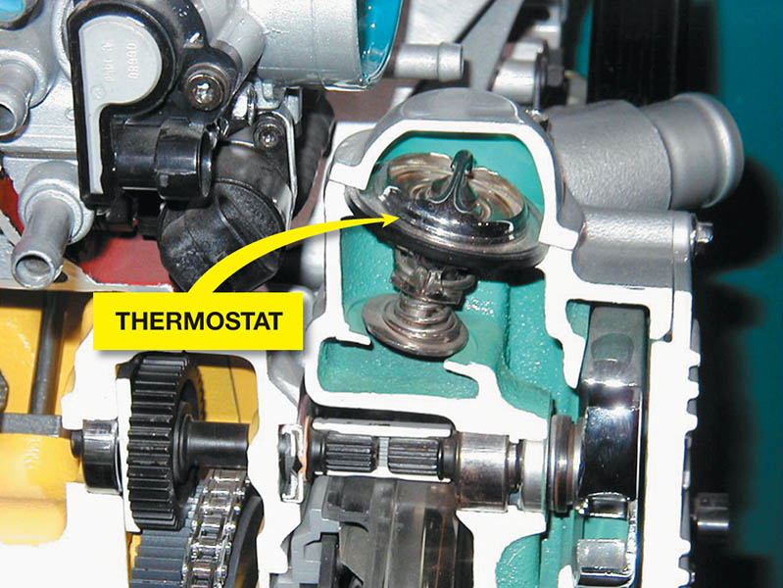
Figure 18.3 The coolant temperature is controlled by the thermostat, which opens and allows coolant to flow to the radiator when the temperature reaches the rating temperature of the thermostat

Slide 10
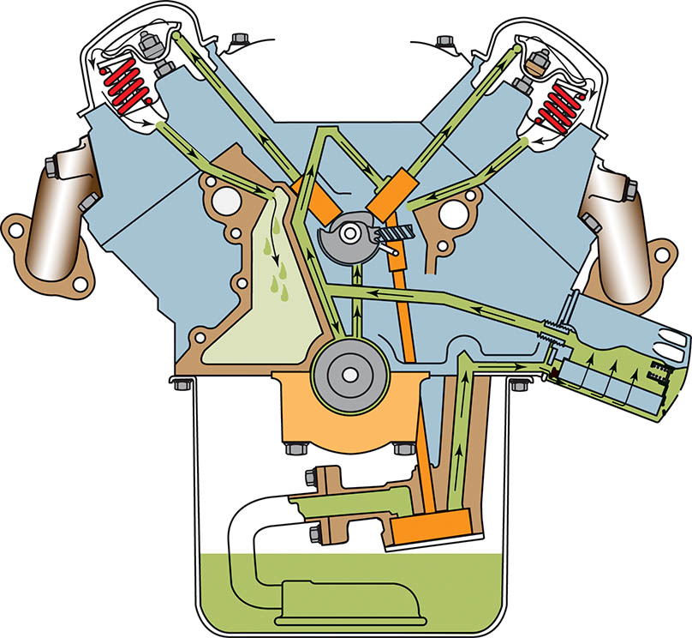
Figure 18.4 A typical lubrication system, showing the oil pan, oil pump, oil filter, and oil passages

Slide 11
FOUR STROKE CYCLE OPERATION
Intake Stroke: The piston moves down drawing air and fuel into the cylinder.
Compression Stroke: The piston moves up in the cylinder compressing the air/fuel mixture.
Power Stroke: The spark ignites the air/fuel mixture forcing the piston down.
Exhaust Stroke: The piston moves up in the cylinder forcing the exhaust gases out of the cylinder.

Slide 12
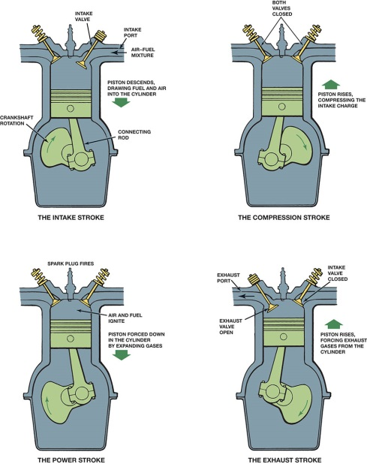
Figure 18.5 The four strokes of the engine are shown below.

Slide 13
QUESTION 1: ?
What are the strokes of a four-stroke cycle engine?

Slide 14
ANSWER 1:
Intake, compression, power, exhaust.

Slide 15
ENGINE CLASSIFICATION AND CONSTRUCTION (1 of 3)
Number of strokes: 4
Cylinder arrangement:
Inline 4,5,and 6 cylinder.
V-type 4, 6, and 8 cylinder
Horizontally opposed 4 and 6 cylinders
Referred too as boxer or pancake engine design

Slide 16
ENGINE CLASSIFICATION AND CONSTRUCTION (2 of 3)
Longitudinal Mounting: Engine mounted parallel with the length of the vehicle.
Transverse Mounting: The engine is mounted crosswise.
Valve and camshaft number and location:
Push rod engine
Cam-in-block design
Overhead valve (OHC)
Single overhead cam (SOHC)
Dual overhead cam (DOHC)

Slide 17
ENGINE CLASSIFICATION AND CONSTRUCTION (3 of 3)
Type of Fuel: Gasoline, E85, M85, Natural Gas, Propane, Diesel.
Cooling Method: Liquid or Air.
Type of Induction Pressure: Naturally aspirated or Turbocharged/Supercharged.
Engine Rotation Direction:
Principle end of motor: Flywheel end of motor
Non-principle end of the motor: The front of the motor.

Slide 18
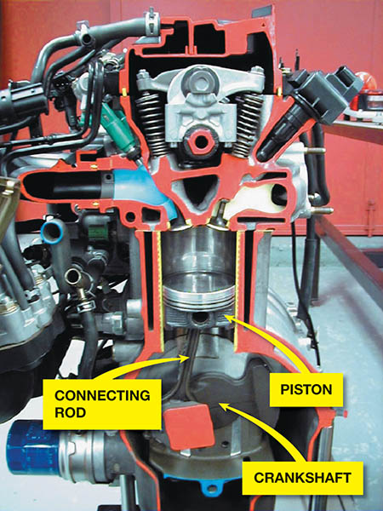
Figure 18.6 Cutaway of an engine showing the cylinder, piston, connecting rod, and crankshaft

Slide 19
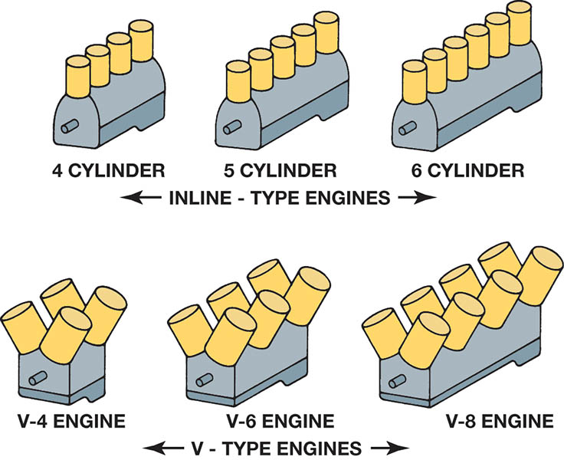
Figure 18.7 Automotive engine cylinder arrangements

Slide 20
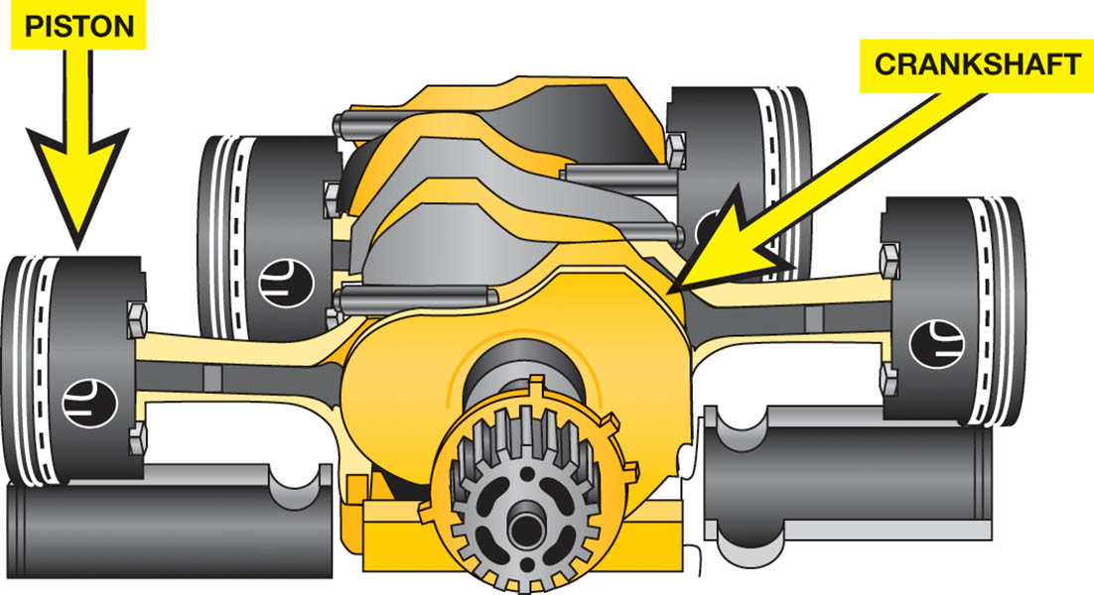
Figure 18.8 A horizontally opposed engine design helps to lower the vehicle’s center of gravity

Slide 21
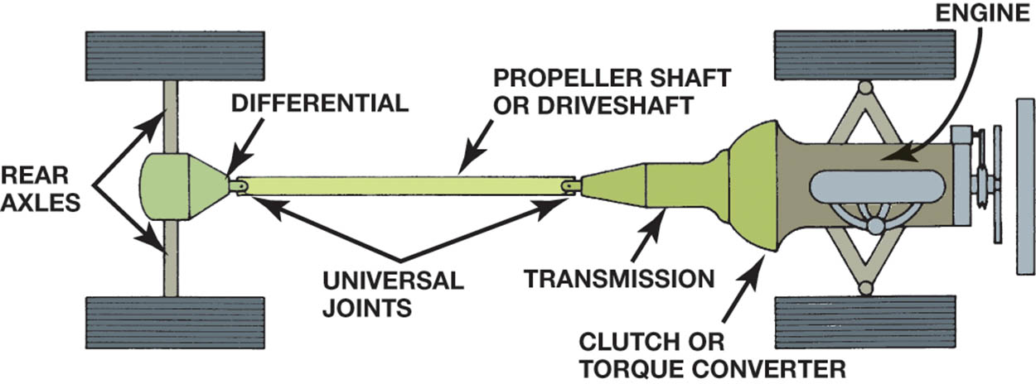
Figure 18.9 A longitudinally mounted engine drives the rear wheels through a transmission, driveshaft, and differential assembly

Slide 22
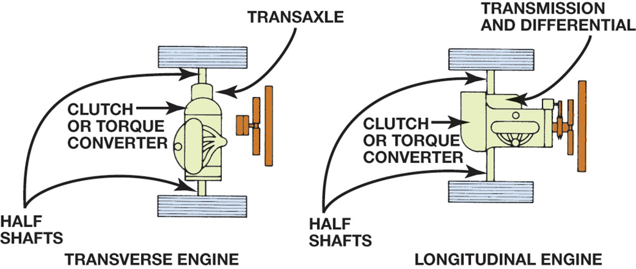
Figure 18.10 Two types of front-engine, front-wheel drive mountings

Slide 23
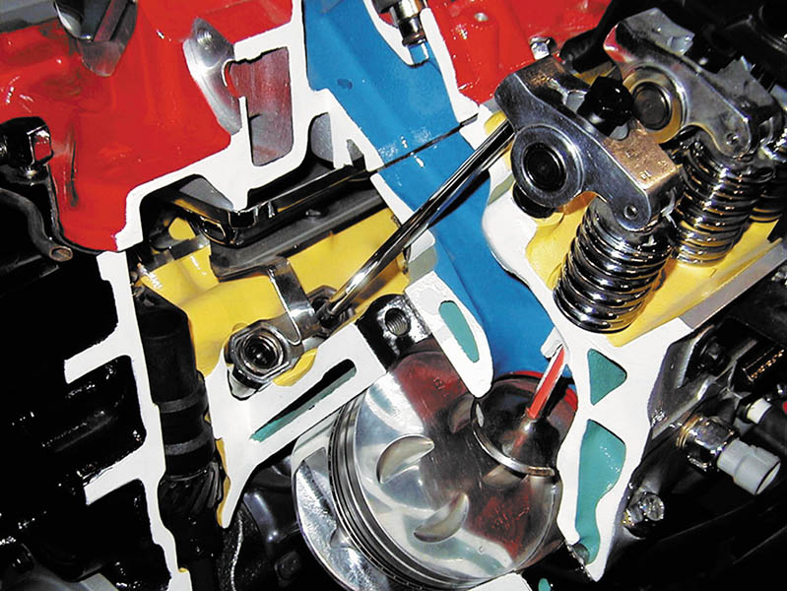
Figure 18.11 Cutaway of an overhead valve (OHV) V-8 engine showing the lifters, pushrods, roller rocker arms, and valves

Slide 24
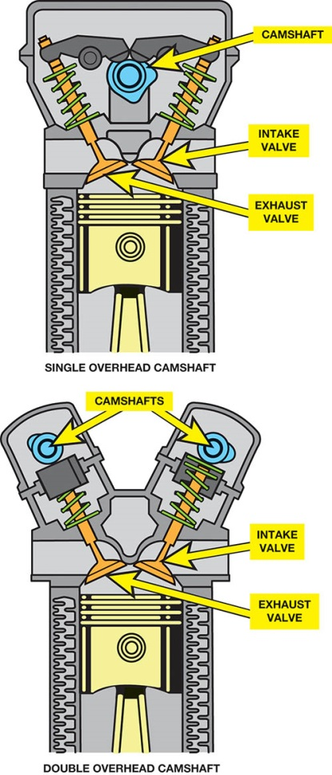
Figure 18.12 SOHC engines usually require additional components, such as a rocker arm, to operate all of the valves. DOHC engines often operate the valves directly

Slide 25
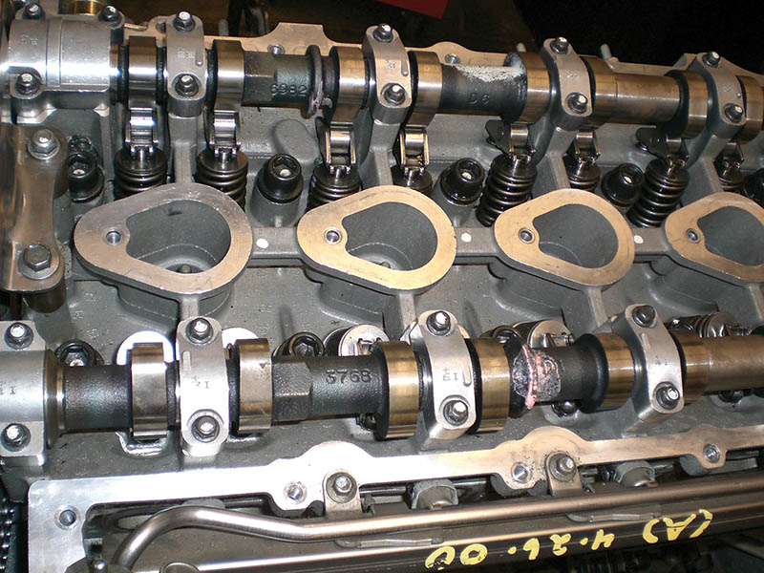
Figure 18.13 A DOHC engine uses a camshaft for the intake valves and a separate camshaft for the exhaust valves in each cylinder head

Slide 26
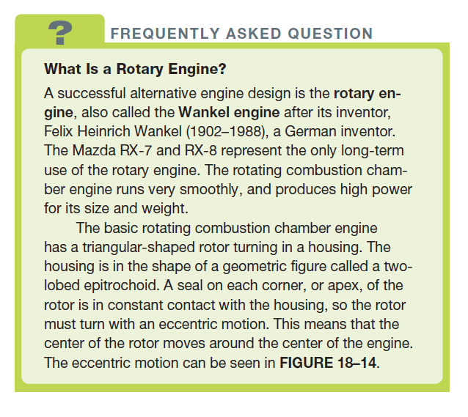
FREQUENTLY ASKED QUESTION

Slide 27
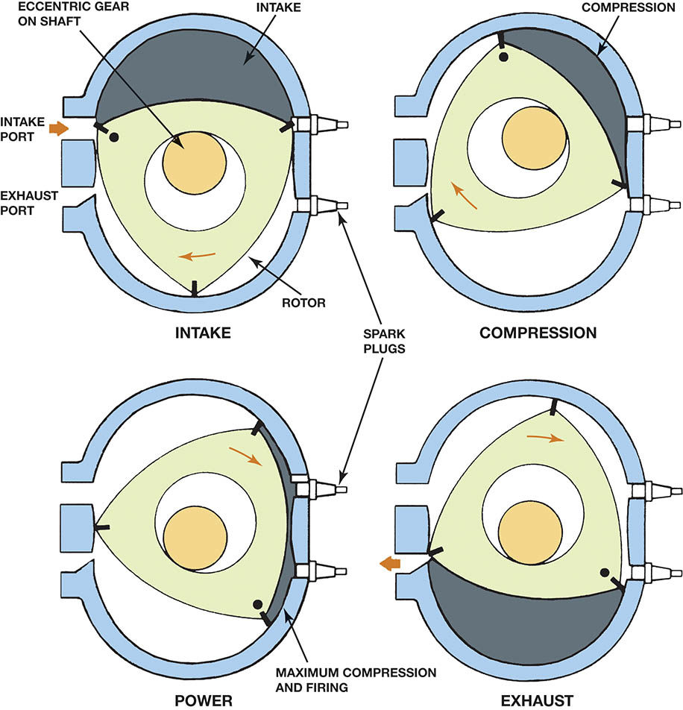
Figure 18.14 A rotary engine operates on the four-stroke cycle, but uses a rotor instead of a piston and crankshaft to achieve intake, compression, power, and exhaust stroke

Slide 28
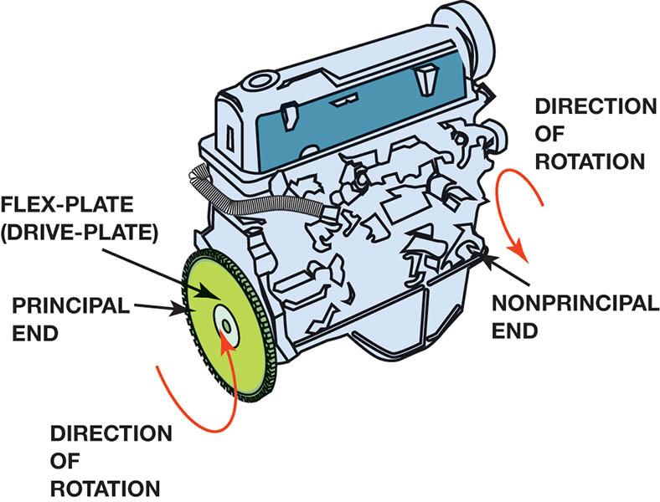
Figure 18.15 Inline 4-cylinder engine showing principal and nonprincipal ends. Normal direction of rotation is clockwise (CW) as viewed from the front or accessory belt (nonprincipal) end

Slide 29
ENGINE MEASUREMENT
Bore: The diameter of the cylinder.
Stroke: The distance the piston travels from top dead center (TDC) to bottom dead center (BDC).
Displacement: It the cubic inches or cubic centimeters of volume displaced by all cylinders.
Conversion to liters: Cubic inches divided by 61.02 equals liters.

Slide 30
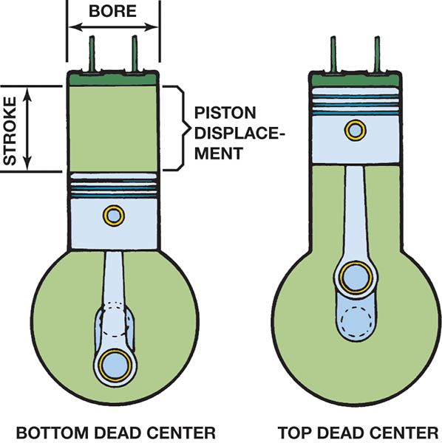
Figure 18.16 The bore and stroke of pistons are used to calculate an engine’s displacement

Slide 31
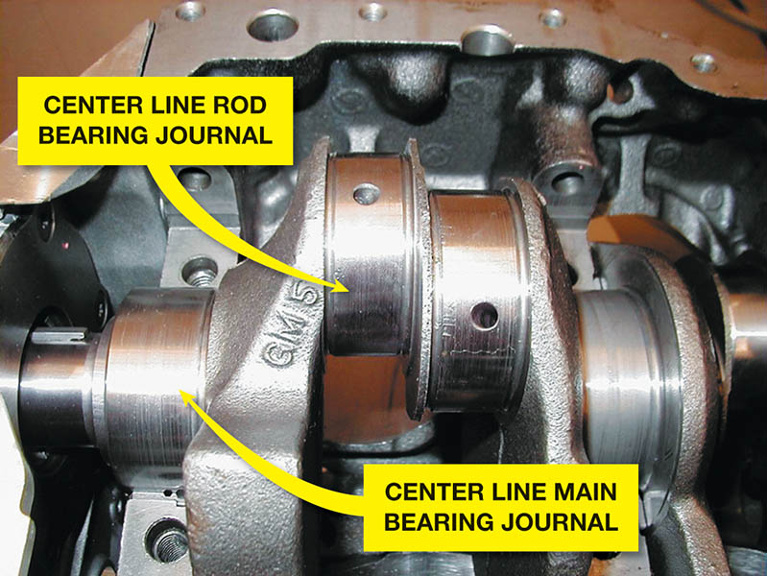
Figure 18.17 The distance between the centerline of the main bearing journal and the centerline of the connecting rod journal determines the stroke of the engine.

Slide 32
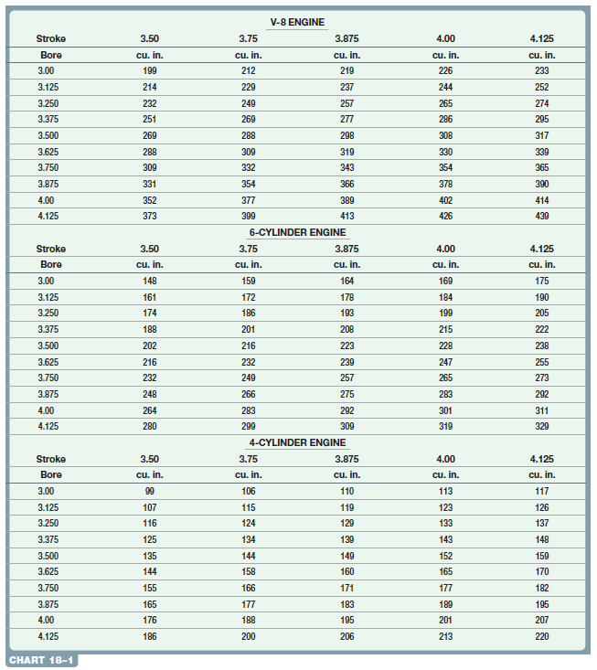
Chart 18-1: To find the cubic inch displacement, find the bore that is closest to the actual value, then go across to the closest stroke value

Slide 33
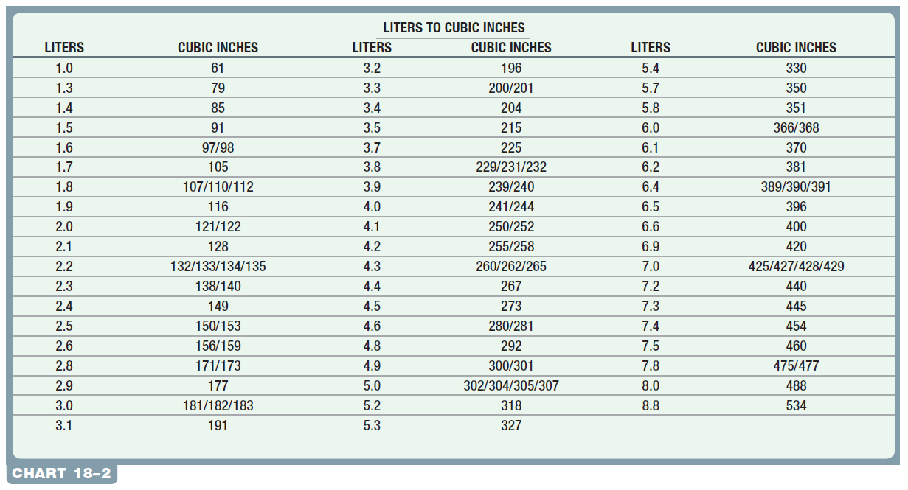
Chart 18-2: Liters to cubic inches is often not exact and can result in representing several different engine sizes based on their advertised size in liters.

Slide 34
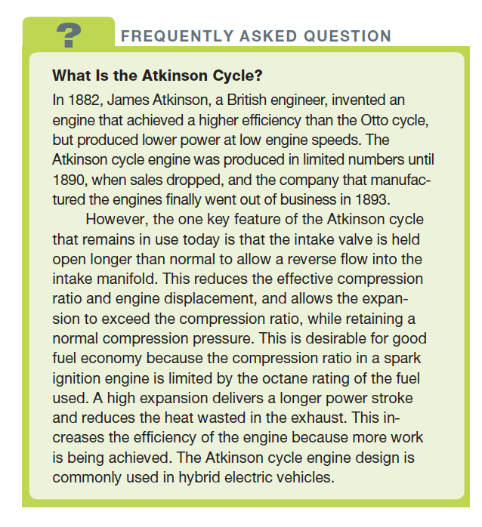
FREQUENTLY ASKED QUESTION

Slide 35
QUESTION 2: ?
What is the bore of the engine?

Slide 36
ANSWER 2:
The diameter of the cylinder.

Slide 37
COMPRESSION RATIO
Compression Ratio (CR): The difference in volume when the piston is at bottom dead center (BDC) versus top dead center (TDC).
Changing Compression Ratio:
Head gasket thickness
Increasing cylinder size

Slide 38
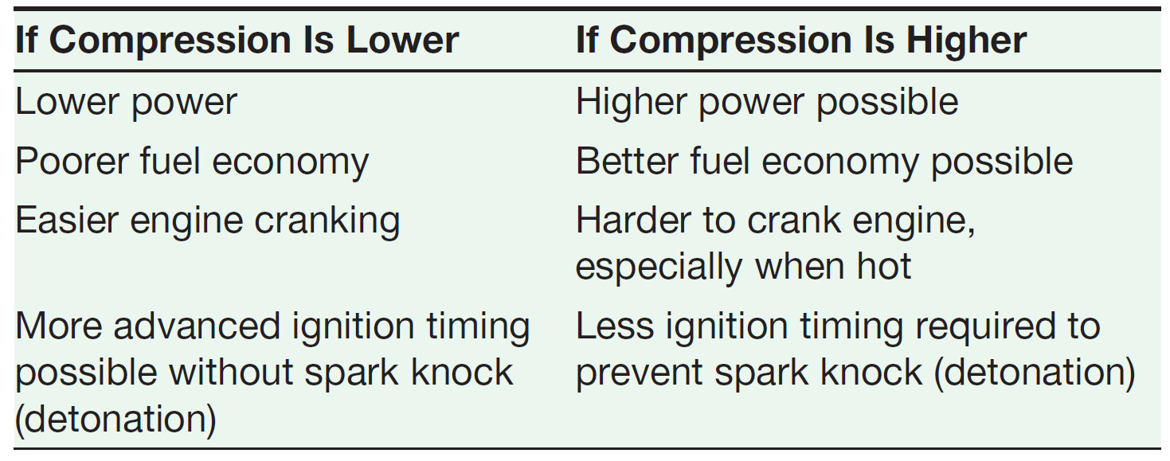
Compression ratio (CR)

Slide 39
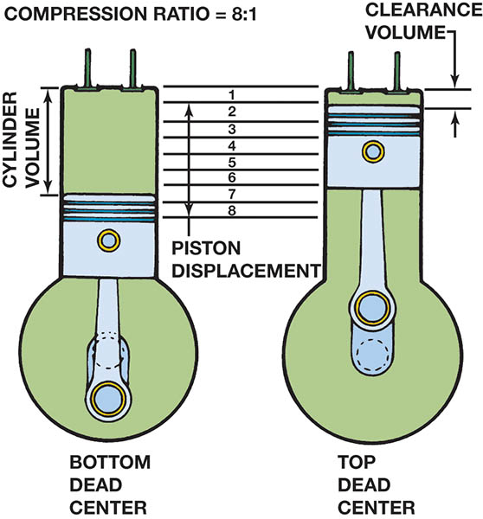
Figure 18.18 Compression ratio is the ratio of the total cylinder volume (when the piston is at the bottom of its stroke) to the clearance volume (when the piston is at the top of its stroke)

Slide 40
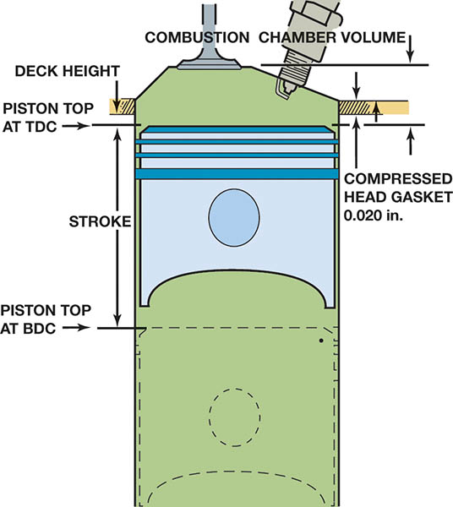
Figure 18.19 Combustion chamber volume is the volume above the piston when the piston is at top dead center

Slide 41
TORQUE AND HORSEPOWER
Torque: A rotating force that may or may not result in movement. The amount of force multiplied the length of the lever through which it acts.
Horsepower: The power required to move 550 pounds one foot in one second.
Horsepower and Altitude: Horsepower is reduced as altitude is increased. SAE says a naturally aspirated engine loses 3% of its power every 1000 feet (300 m) of altitude increase.
.

Slide 42
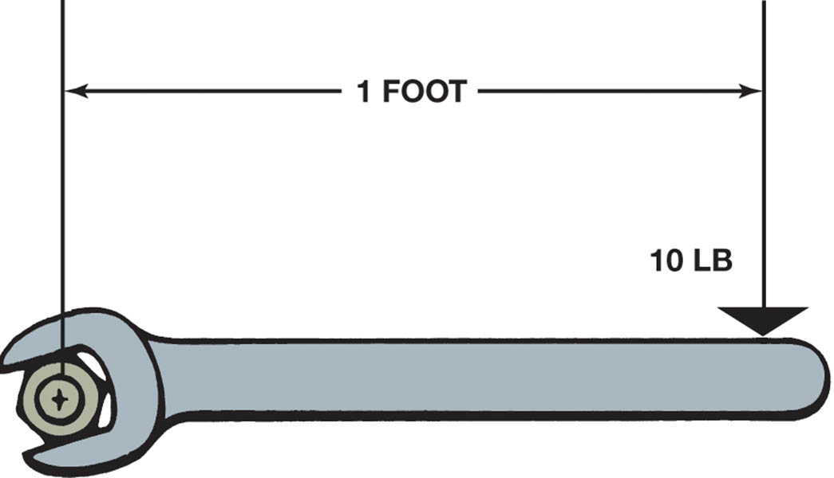
Figure 18.20 Torque is a twisting force equal to the distance from the pivot point times the force applied expressed in units called pound-feet (lb-ft) or newton-meters (N-m)

Slide 43
QUESTION 3: ?
What is the definition of torque?

Slide 44
ANSWER 3:
The amount of force multiplied the length of the lever through which it acts.

Slide 45
Copyright

