Slide 1
What is a point?
1. Point-An exact location in space, usually represented by a dot Example: Symbol: point A

Slide 2
What is a line?
2. Line- a straight path in a plane that goes on forever in opposite directions Example:
Symbol

Slide 3
What is a line segment?
3. line segment-A part of a line that includes two points, called endpoints, and all of the points between them Example:
line segment AB or line segment BA
Symbol:

Slide 4
What is a ray?
4. Ray-A part of a line, with one endpoint, that continues without end in one direction Example: ray CD
Symbol:

Slide 5
What is a parallel line?
5. parallel lines-Lines in a plane that never intersect Example:
Symbol:

Slide 6
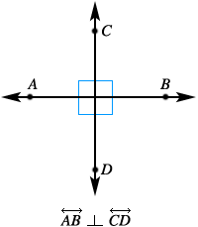
What is a perpendicular line?
6. Perpendicular lines-Two lines that intersect to form four right angles Example: Symbol:

Slide 7
7. Intersecting lines-Lines that cross each other but don’t form right angles.

Slide 8
8. Angle-Is formed when two rays share a common endpoint.
We Can write angles three different ways
Symbol
T
C
V

Slide 9
Lines & Angles
Notes:
Let me now how this works for your class. Did you need to modify anything, etc.?
Dr. Don L. Fisher fisher_d@madera.k12.ca.us

Slide 10
Name each figure
Point
Line
Ray
Line Segment
Perpendicular
Intersecting
Parallel

Slide 11
.
point

Slide 12
ray

Slide 13
line segment

Slide 14
line

Slide 15
parallel lines

Slide 16
intersecting lines

Slide 17
perpendicular
lines

Slide 18
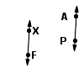
What is it?
Is the following shape a parallel line, a
perpendicular line, or an intersecting line?

Slide 19
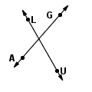
What is it?
Is the following shape a parallel line, a
perpendicular line, or an intersecting line?

Slide 20
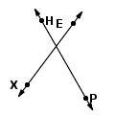
What is it?
Is the following shape a parallel line, a
perpendicular line, or an intersecting line?

Slide 21
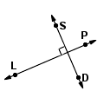
What is it?
Is the following shape a parallel line, a
perpendicular line, or an intersecting line?

Slide 22
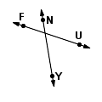
What is it?
Is the following shape a parallel line, a
perpendicular line, or an intersecting line?

Slide 23
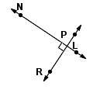
What is it?
Is the following shape a parallel line, a
perpendicular line, or an intersecting line?

Slide 24
What is it?
Is the following shape a parallel line, a
perpendicular line, or an intersecting line?

Slide 25
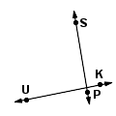
What is it?
Is the following shape a parallel line, a
perpendicular line, or an intersecting line?

Slide 26
What is it?
Is the following a point, a line, a line segment, or a ray?

Slide 27
What is it?
Is the following a point, a line, a line segment, or a ray?

Slide 28
What is it?
Is the following a point, a line, a line segment, or a ray?

Slide 29
What is it?
Is the following a point, a line, a line segment, or a ray?

Slide 30
What is it?
Is the following a point, a line, a line segment, or a ray?

Slide 31
What is it?
Is the following a point, a line, a line segment, or a ray?

Slide 32
What is it?
Is the following a point, a line, a line segment, or a ray?

