Slide 1
Automotive Technology Principles, Diagnosis, and Service
Sixth Edition
Chapter 21
Cooling System, Operation and Diagnosis
Copyright © 2018, 2015, 2011 Pearson Education, Inc. All Rights Reserved

Slide 2
LEARNING OBJECTIVES (1 of 2)
21.1 Explain the purpose and function of the cooling system, and cooling system operation.
21.2 Explain the purpose of thermostats, radiators, pressure caps, and water pumps.
21.3 Explain coolant flow in the engine and coolant recovery systems.

Slide 3
LEARNING OBJECTIVES (2 of 2)
21.4 Explain the purpose of cooling fans and heater cores.
21.5 Describe cooling system testing and explain the purpose of coolant temperature warning light.
21.6 Explain cooling system inspection and cooling system service.

Slide 4
COOLING SYSTEM PURPOSE AND FUNCTION
The cooling system is designed to remove approximately 1/3 of the heat generated by the engine.
Low Temperature Problems: An engine that fails to reach operating temperature potentially generates high tailpipe emissions.
High Temperature Problems: High operating temperatures can create spark knock and cause mechanical engine damage.

Slide 5
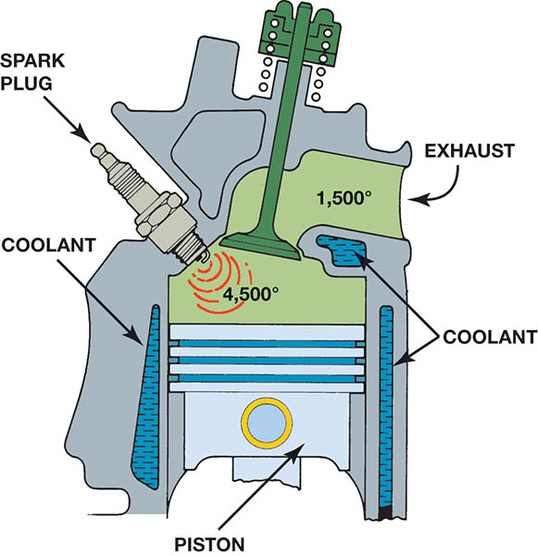
Figure 21.1 Typical combustion and exhaust temperatures

Slide 6
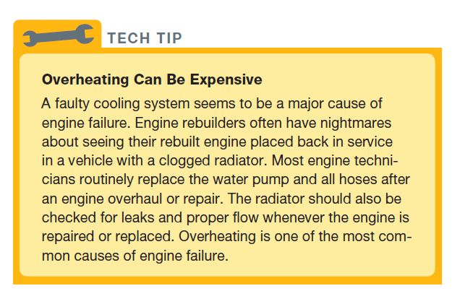
TECH TIP

Slide 7
COOLING SYSTEM OPERATION
Coolant flows through the engine and absorbs heat. It then flows through the radiator where it dissipates the heat.
The coolant flow rate may be as high as 1 gallon (4 liters) per minute for each horsepower the engine produces.
Radiators are designed for the maximum rate of heat transfer using minimum space.

Slide 8
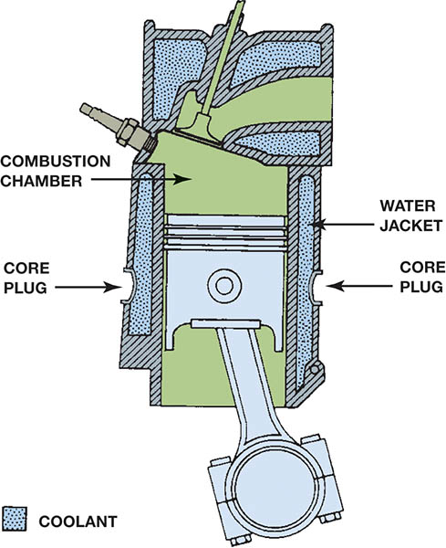
Figure 21.2 Coolant circulates through the water jackets in the engine block and cylinder head

Slide 9
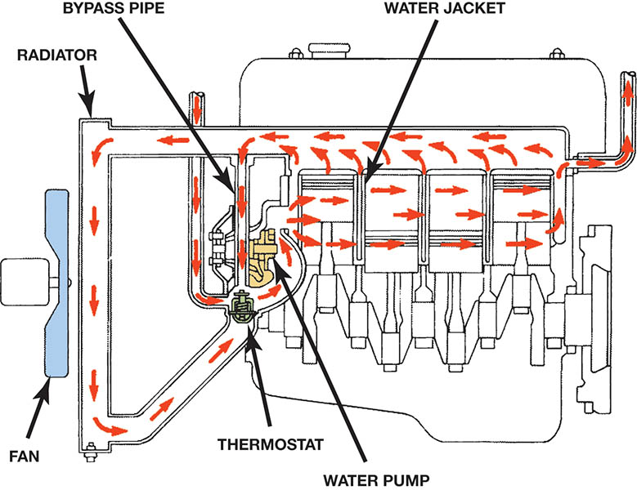
Figure 21.3 Coolant flow through a typical engine cooling system

Slide 10
THERMOSTATS (1 of 2)
The thermostat is designed to control the minimum normal operating temperature of the engine.
A wax-based plastic pellet is on the engine side of the thermostat.
As the engine warms the pellet swells and moves a mechanical link that opens the thermostat allowing coolant to flow to the radiator.

Slide 11
THERMOSTATS (2 of 2)
Thermostat testing:
Hot water method
Infrared thermometer method
San tool method
Thermostat replacement:
Engine may overheat
Engine may fail to reach operating temperature
Replace O-ring or gasket when replacing thermostat.
Some thermostats are an integral part of the housing.

Slide 12
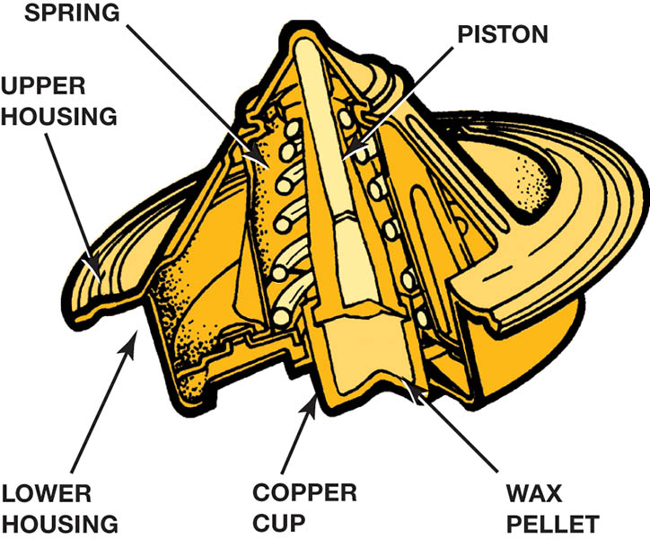
Figure 21.4 A cross section of a typical wax-actuated thermo-stat showing the position of the wax pellet and spring

Slide 13
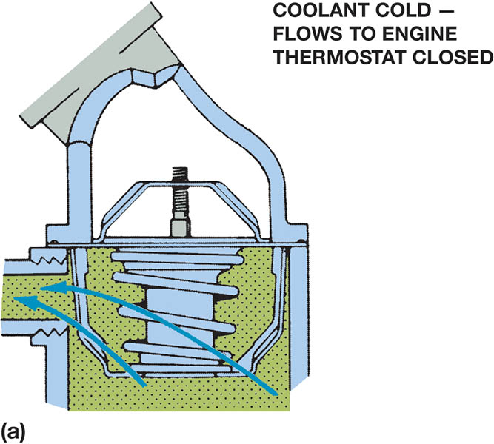
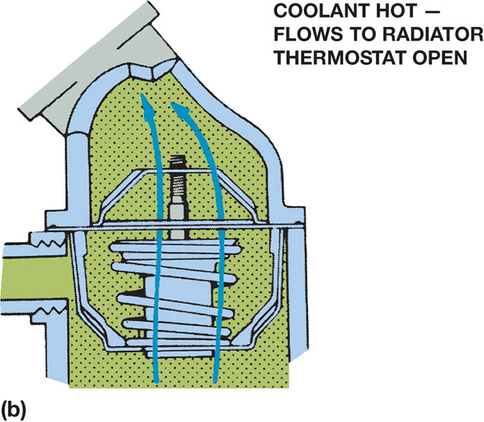
Figure 21.5 (a) When the engine is cold, the coolant flows through the bypass. (b) When the thermostat opens, the coolant can flow to the radiator

Slide 14
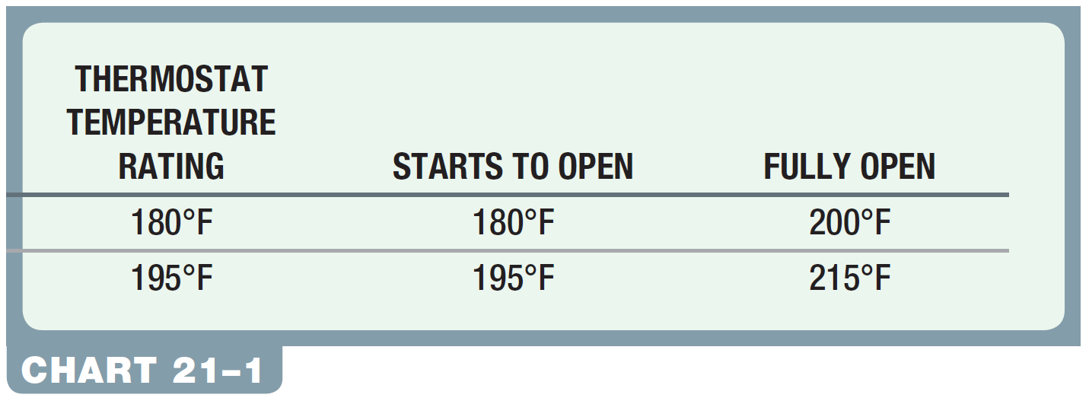
CHART 21-1: The temperature of the coolant depends on the rating of the thermostat.

Slide 15
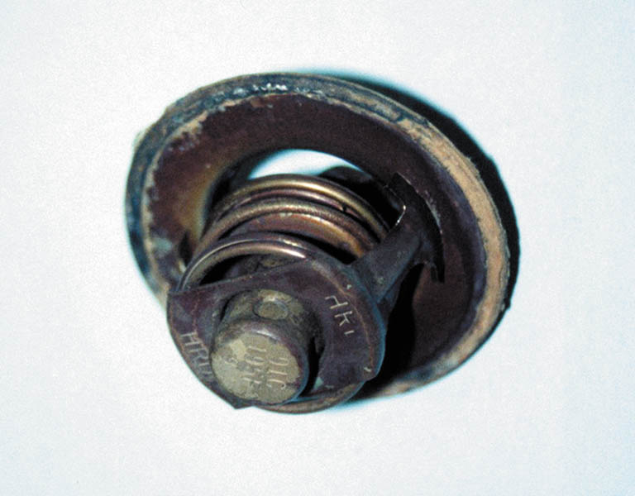
Figure 21.6 A thermostat stuck in the open position caused the engine to operate too cold. If a thermostat is stuck closed, this can cause the engine to overheat

Slide 16
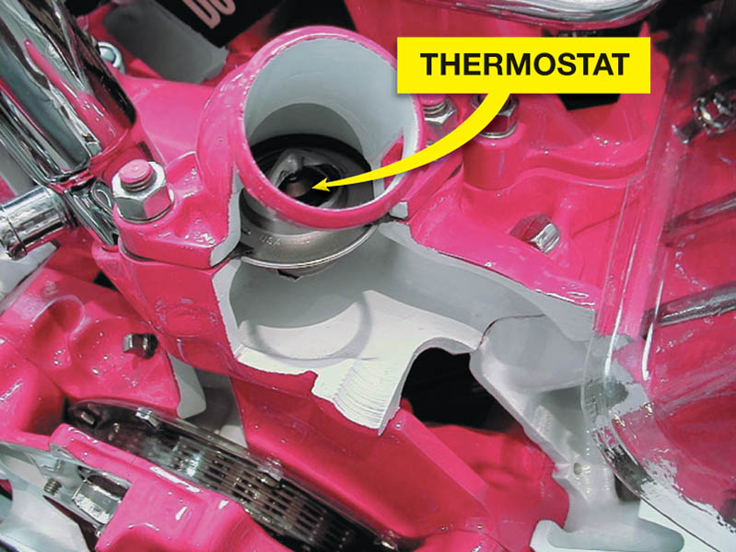
Figure 21.7 A cutaway of a small block Chevrolet V-8 showing the passage from the cylinder head through the front of the intake manifold to the thermostat

Slide 17
Tech Tip

Slide 18
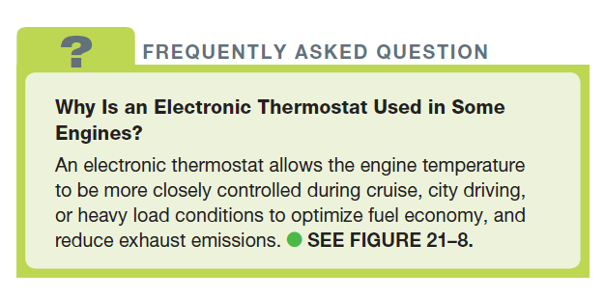
FREQUENTLY ASKED QUESTION

Slide 19
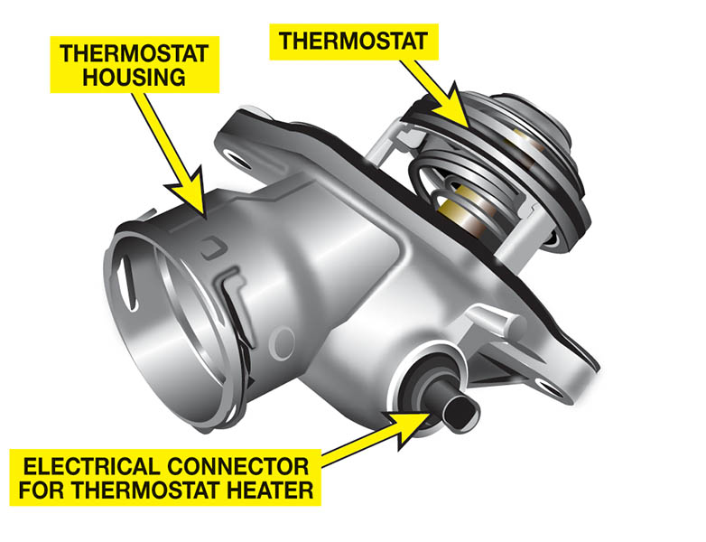
Figure 21.8 An electronic thermostat uses a wax pellet to open and a spring to close it, but it also uses an electric heater controlled by the powertrain control module (PCM) to accurately control engine coolant temperature

Slide 20
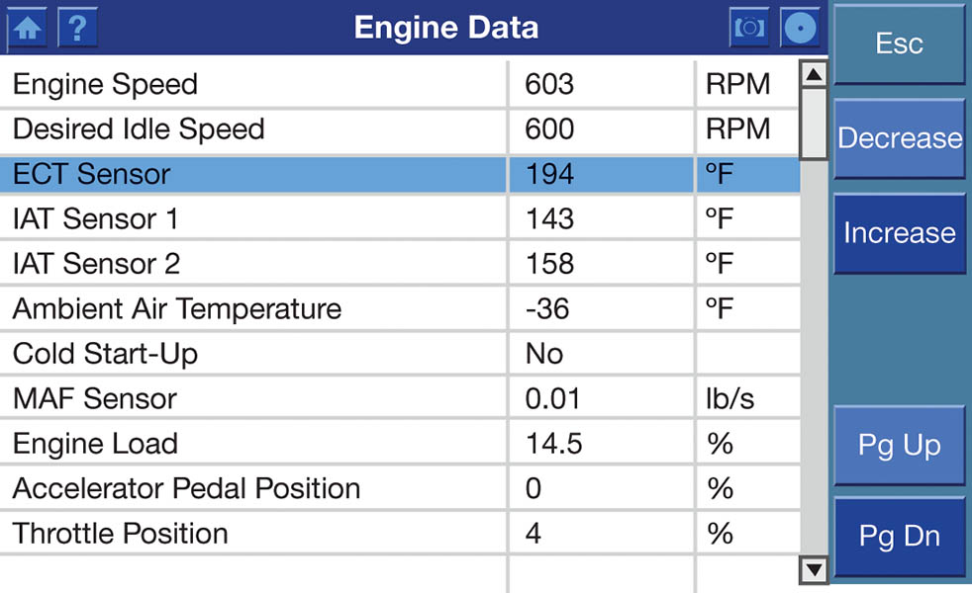
Figure 21.9 A scan tool can be used to monitor the engine coolant temperature (ECT)

Slide 21
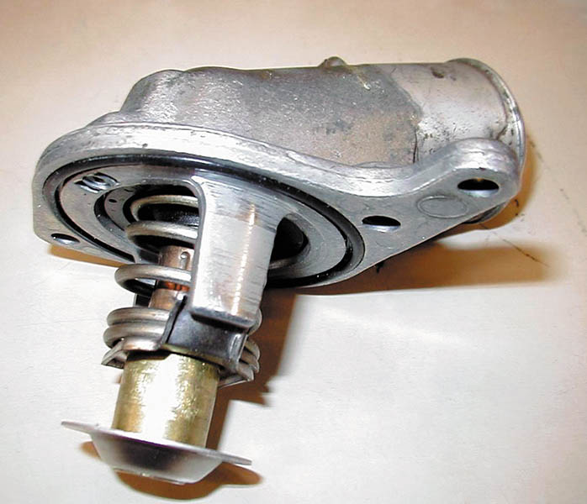
Figure 21.10 Some thermostats are an integral part of the housing. This thermostat and radiator hose housing is serviced as an assembly. Some thermostats snap into the engine radiator fill tube underneath the pressure cap

Slide 22
QUESTION 1: ?
What are the three methods for testing a thermostat?

Slide 23
ANSWER 1:
Hot water, scan tool, and infrared methods.

Slide 24
RADIATORS
Serpentine fine core
Plate fin core
Coolant flows through the core tubes.
Cooling fins dissipate the heat.
Down-flow design
Cross-flow design
Transmission cooler may be in the outlet tank.

Slide 25
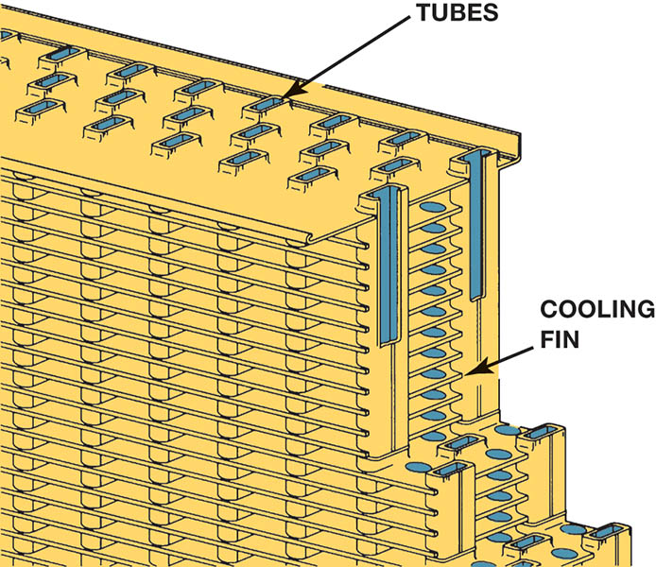
Figure 21.11 The tubes and fins of the radiator core

Slide 26
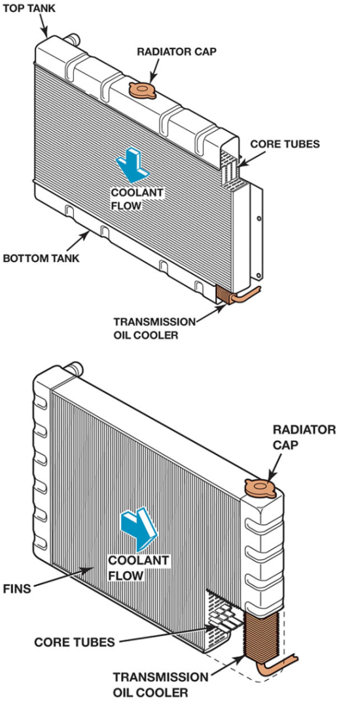
Figure 21.12 A radiator may be either a down-flow or a cross-flow type

Slide 27
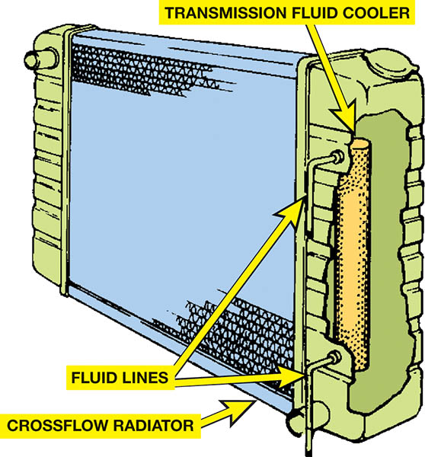
Figure 21.13 Many vehicles equipped with an automatic transmission use a transmission fluid cooler installed in one of the radiator tanks

Slide 28
PRESSURE CAPS
Raise the boiling point of the coolant 3° F (16° C) for every pound of pressure increase.
Allows for engine temperatures above 220° F (93° C) without overheating the engine.
Caps are rated in PSI or BAR depending on the manufacturer.
Pressure and vacuum valves allow coolant into the overflow bottle under high heat and back into the radiator on cooling.

Slide 29
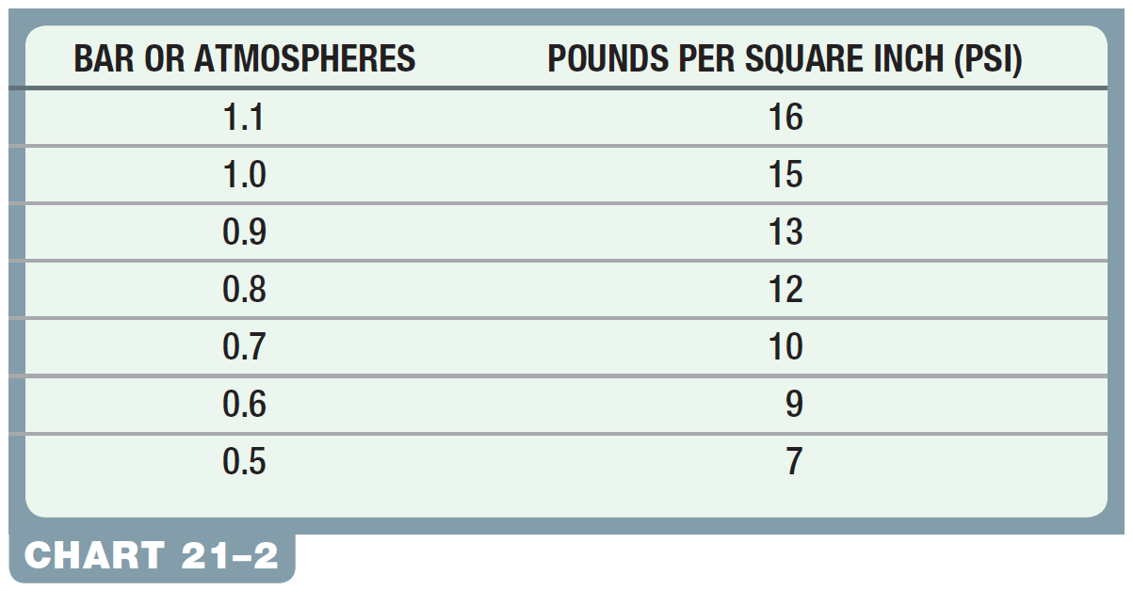
CHART 21-2: Comparison showing the metric pressure as shown on the top of the cap to pounds per square inch (PSI).

Slide 30
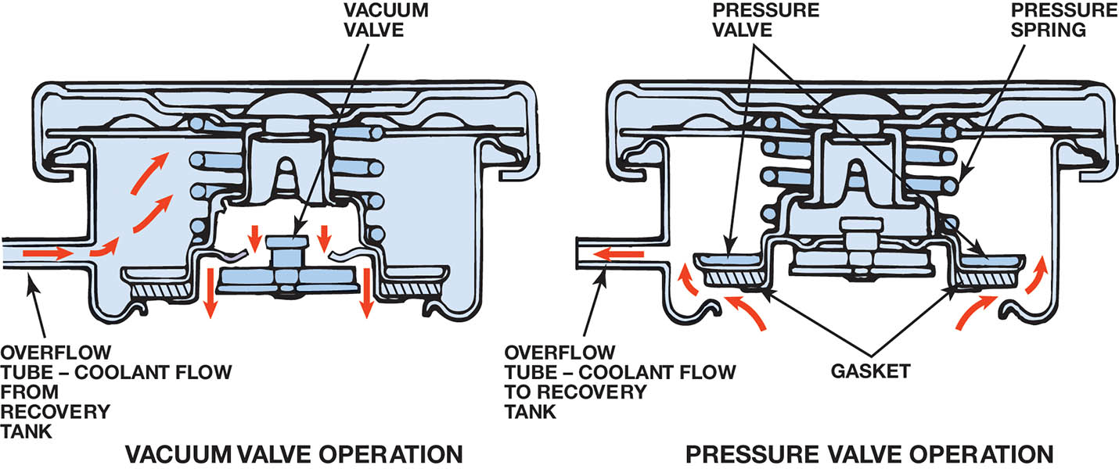
Figure 21.14 The pressure valve maintains the system pressure and allows excess pressure to vent. The vacuum valve allows coolant to return to the system from the recovery tank

Slide 31
QUESTION 2: ?
Why is a cooling system pressurized?

Slide 32
ANSWER 2:
To raise the operating temperature without overheating the engine.

Slide 33
COOLANT RECOVERY SYSTEMS
Contains the coolant that is forced passed the radiator cap under high pressures.
When the system cools, coolant from the recovery system is drawn back into the radiator.
A surge tank may be used. It is at the highest point of the cooling system and has a pressure cap.
.

Slide 34
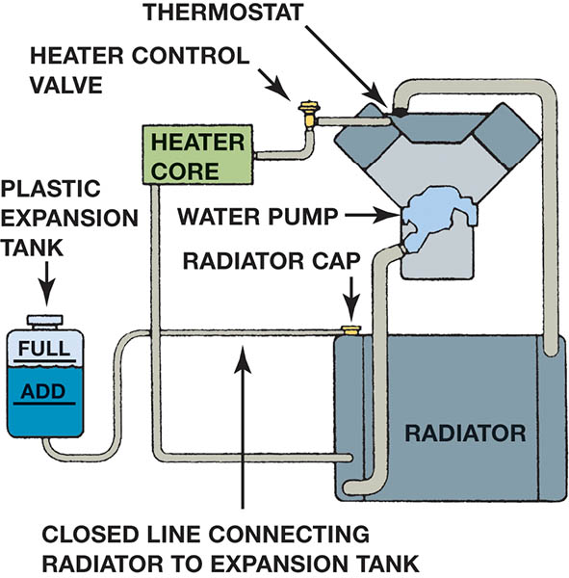
Figure 21.15 The level in the coolant recovery system raises and lowers with engine temperature

Slide 35
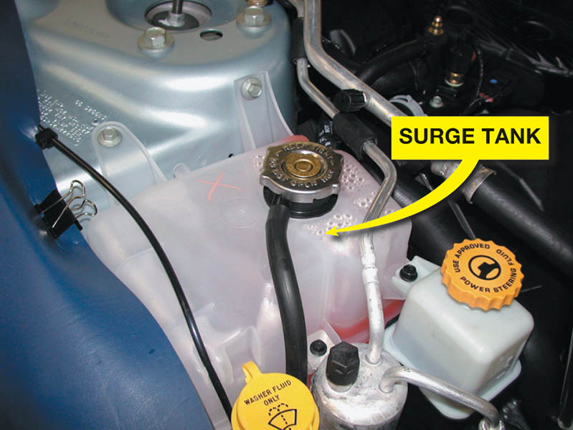
Figure 21.16 Some vehicles use a surge tank, which is located at the highest level of the cooling system, with a radiator cap

Slide 36
WATER PUMPS
A centrifugal pump that moves the coolant without increasing the pressure.
Driven by a crankshaft belt or the camshaft.
Coolant is drawn in at the center of the impeller and forced out at the tips.
The water pump is replaced if it leaks or fails to properly move the coolant mixture.

Slide 37
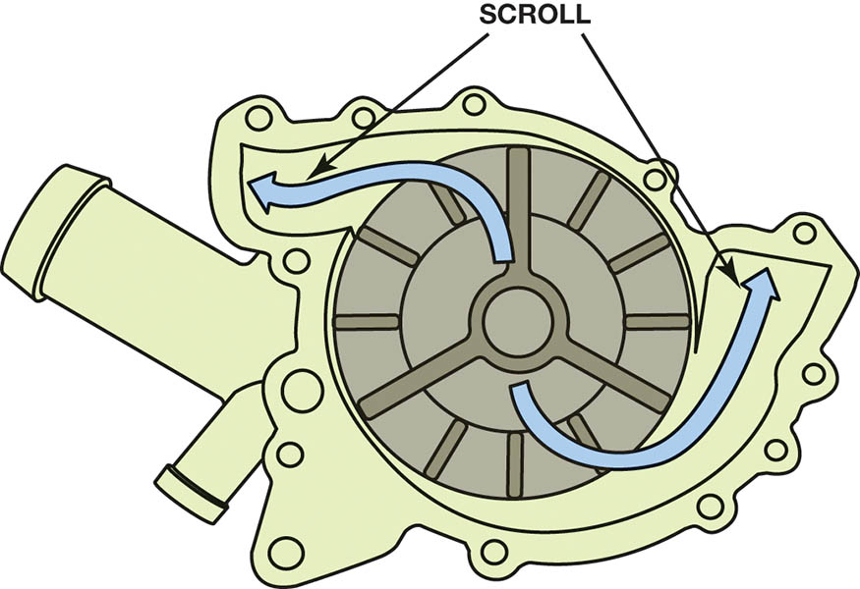
Figure 21.17 Coolant flow through the impeller and scroll of a coolant pump for a V-type engine

Slide 38
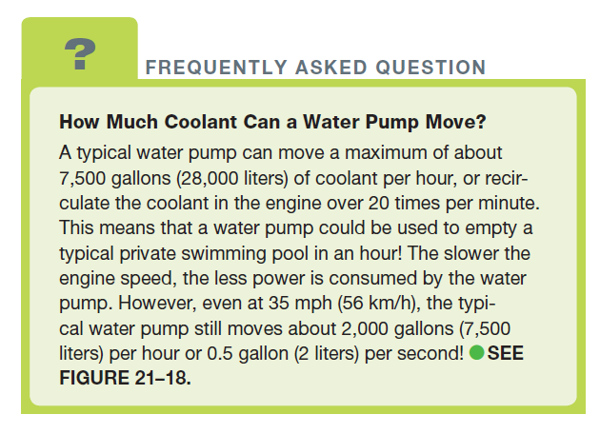
FREQUENTLY ASKED QUESTION

Slide 39
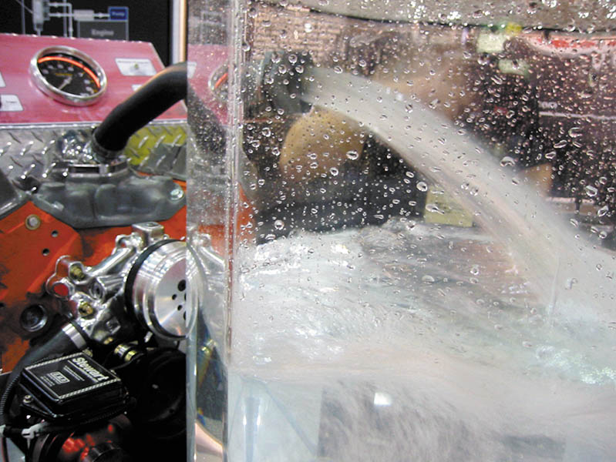
Figure 21.18 A demonstration engine running on a stand, showing the amount of coolant flow that actually occurs through the cooling system

Slide 40
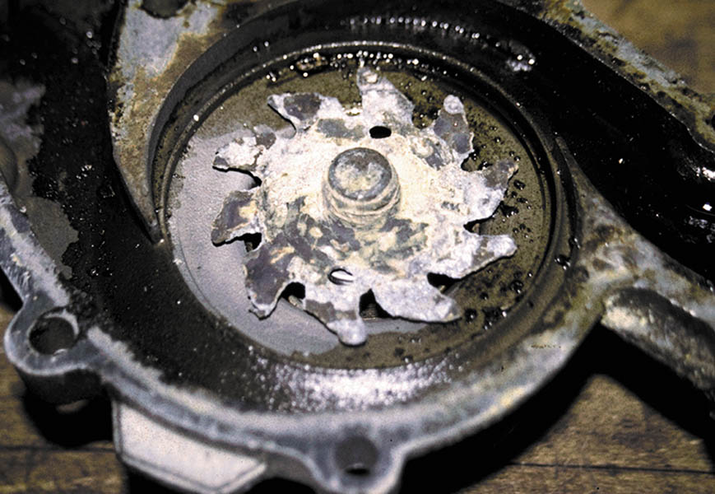
Figure 21.19 This severely corroded water pump could not circulate enough coolant to keep the engine cool. As a result, the engine overheated and blew a head gasket

Slide 41
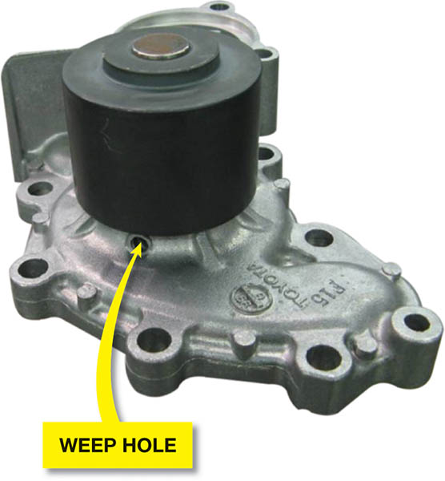
Figure 21.20 The bleed weep hole in the water pump allows coolant to leak out of the pump and not be forced into the bearing. If the bearing failed, more serious damage could result

Slide 42
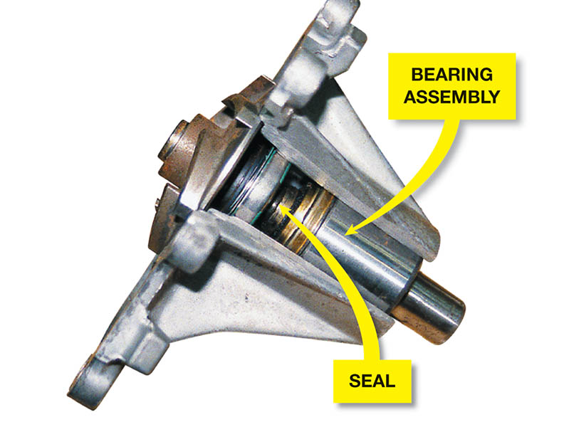
Figure 21.21 A cutaway of a typical water pump showing the long bearing assembly and the seal. The weep hole is located between the seal and the bearing. If the seal fails, then coolant flows out of the weep hole to prevent the coolant from damaging the bearing

Slide 43
COOLANT FLOW IN THE ENGINE
Parallel flow system: Coolant flows into the block and then crosses the head gasket to the head.
Series flow system: The coolant then enters the rear of the heads and flows around all the cylinders.
Series-parallel flow system: Some engines use a combination of these two coolant flow systems.

Slide 44
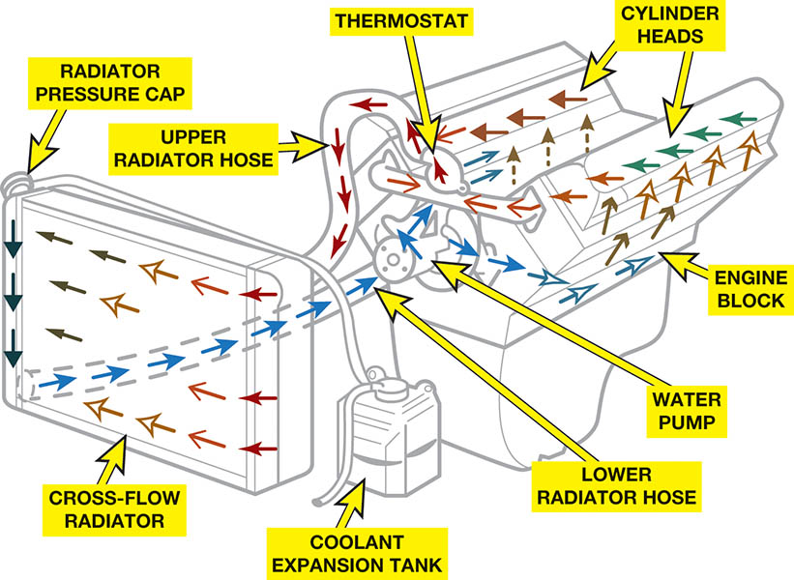
Figure 21.22 A series-type cooling system where the coolant first flows through the engine block, then to the heads, before returning to the radiator after passing through the thermostat

Slide 45
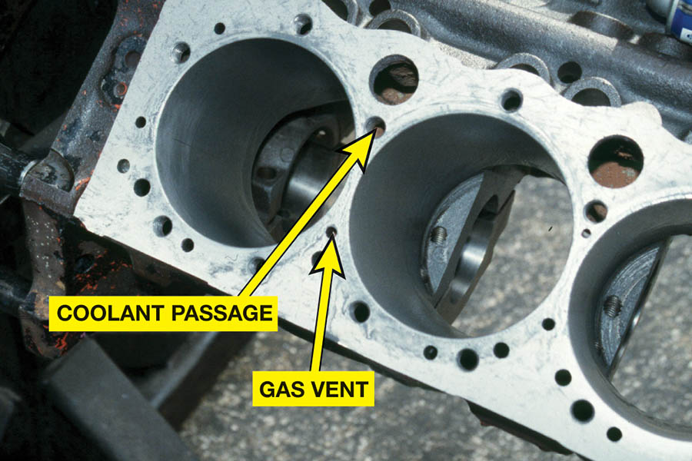
Figure 21.23 A Chevrolet V-8 block that shows the large coolant holes and the smaller gas vent or bleed holes that must match the head gasket when the engine is assembled

Slide 46
QUESTION 3: ?
What are the three coolant flow systems?

Slide 47
ANSWER 3:
Parallel, Series, and Series-Parallel.

Slide 48
COOLING FANS
Electronically controlled:
PCM controlled two speed fan(s).
Coolant temperature, air-conditioning operate and certain fault codes determine operation.
Thermostatic fans:
Belt driven by the crankshaft
Silicone coupling or thermostatic spring determine slip based on temperature.

Slide 49
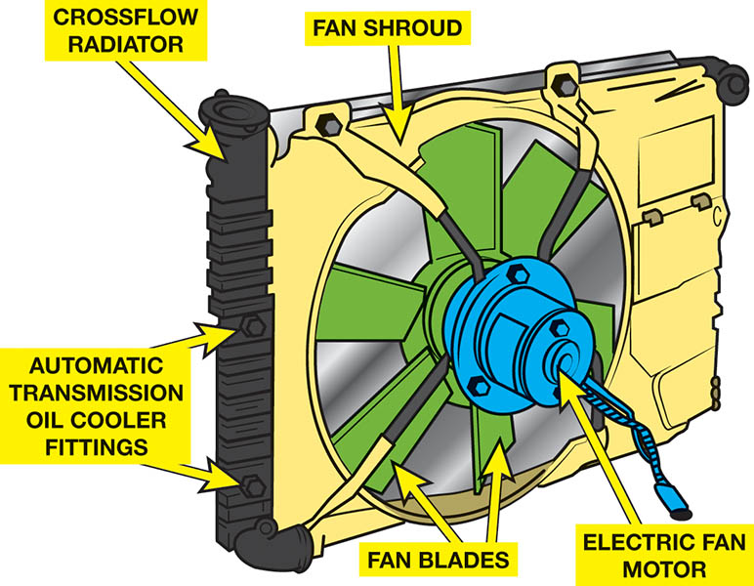
Figure 21.24 A typical electric cooling fan assembly showing the radiator and related components

Slide 50
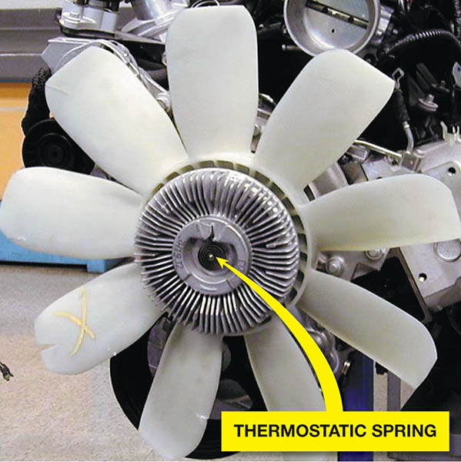
Figure 21.25 A typical engine-driven thermostatic spring cooling fan

Slide 51
HEATER CORES
Heated coolant is passed through tubes in the small core of the heater. Air is passed across the heater fins and is then sent to the passenger compartment.
Heater Problem Diagnosis:
Engine temperature not high enough to generate heat.
Coolant is not able to flow through a restricted heater core.
A malfunction of the temperature blend-air door system.

Slide 52
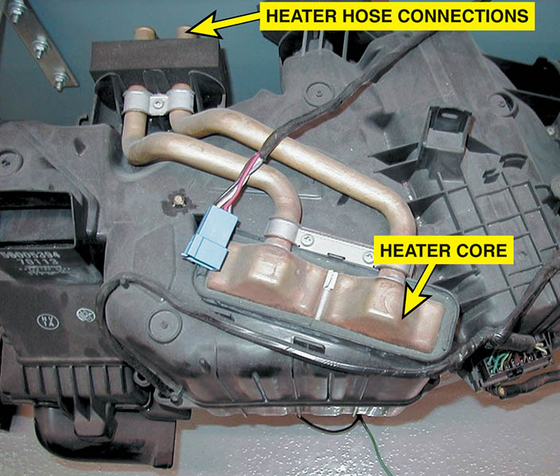
Figure 21.26 A typical heater core installed in a heating, ventilation, and air-conditioning (HVAC) housing assembly

Slide 53
COOLING SYSTEM TESTING
Visual Inspection: All external system components can be visually inspected.
Pressure Testing: Used to determine the location of a leak by pressurizing the system and the cap.
Coolant Dye Testing: The insertion of dye into the cooling system and the use of a black light may locate difficult to find leaks.

Slide 54
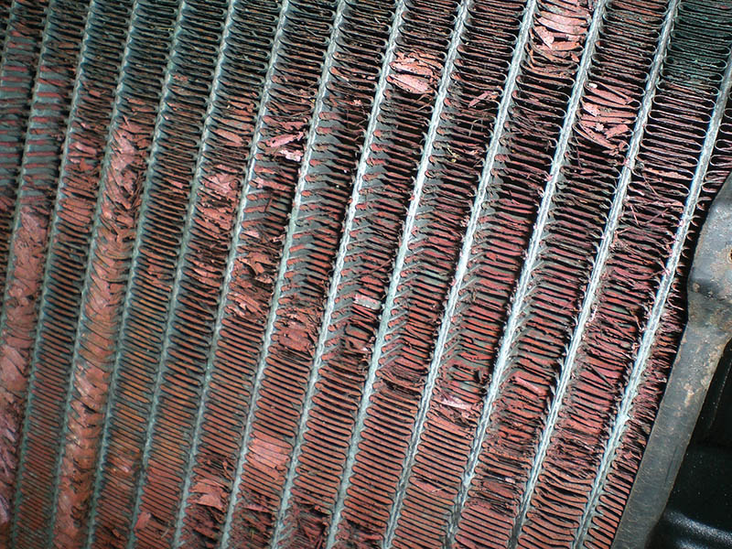
Figure 21.27 A heavily corroded radiator from a vehicle that was overheating. A visual inspection discovered that the corrosion had eaten away many of the cooling fins, yet did not leak. This radiator was replaced and it solved the overheating problem

Slide 55
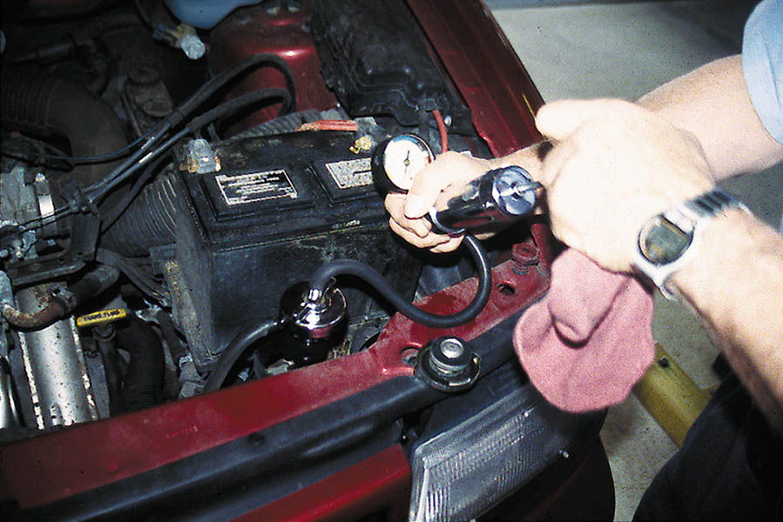
Figure 21.28 Pressure testing the cooling system. A typical hand-operated pressure tester applies pressure equal to the radiator cap pressure. The pressure should hold; if it drops, this indicates a leak somewhere in the cooling system.

Slide 56
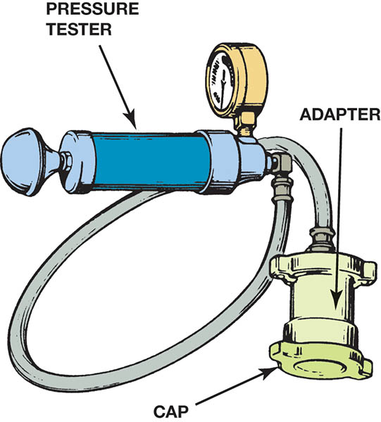
Figure 21.29 The pressure cap should be checked for proper operation using a pressure tester as part of the cooling system diagnosis

Slide 57
Figure 21.30 Use dye specifically made for coolant when checking for leaks using a black light

Slide 58
COOLANT TEMPERATURE WARNING LIGHT
Typically illuminates when operating temperatures exceed 250° F to 258° F. (120° C to 126° C).
Common Causes of Overheating:
Low coolant level
Plugged, dirty or blocked radiator
Defective fan clutch or electric fan
Broken fan drive belt
Defective radiator cap
Defective water pump
Blocked cooling passages

Slide 59
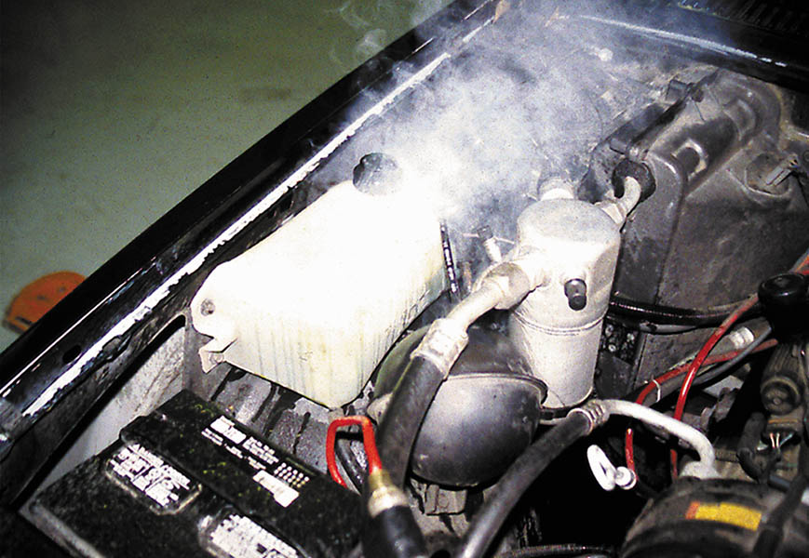
Figure 21.31 When an engine overheats, often the coolant overflow container boils

Slide 60
COOLING SYSTEM INSPECTION
Coolant Level:
A visual inspection for signs of coolant system leaks and for the condition of the coolant hoses and fan drive belts.
Accessory Drive Belt Tension:
Belt tension gauge
Marks on a tensioner
Torque wrench reading
Deflection

Slide 61
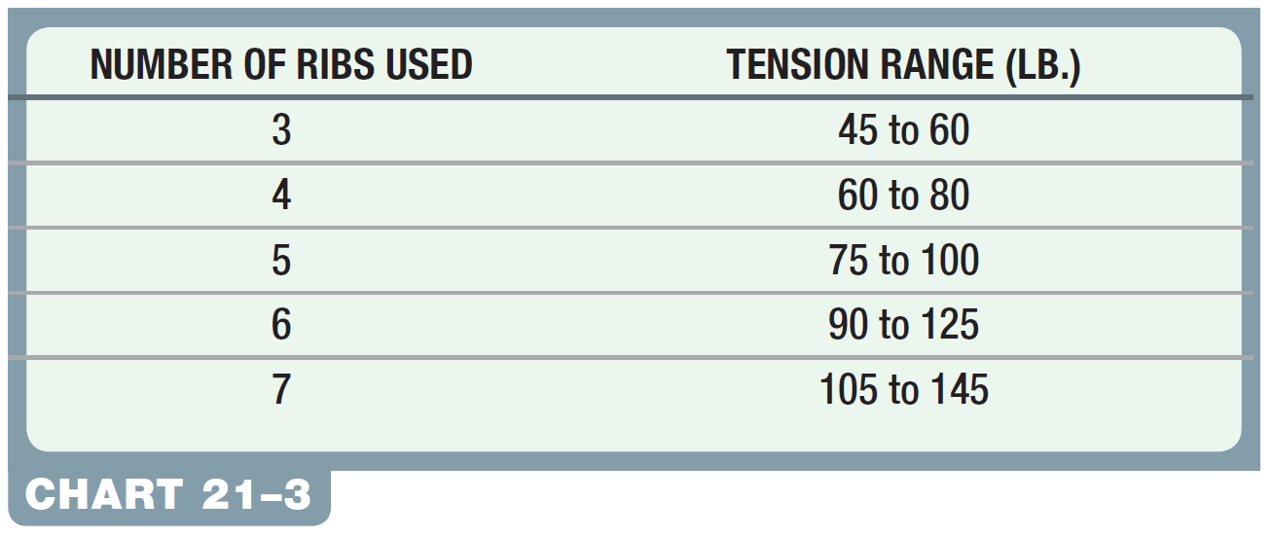
CHART 21-3: The number of ribs determines the tension range of the belt.

Slide 62
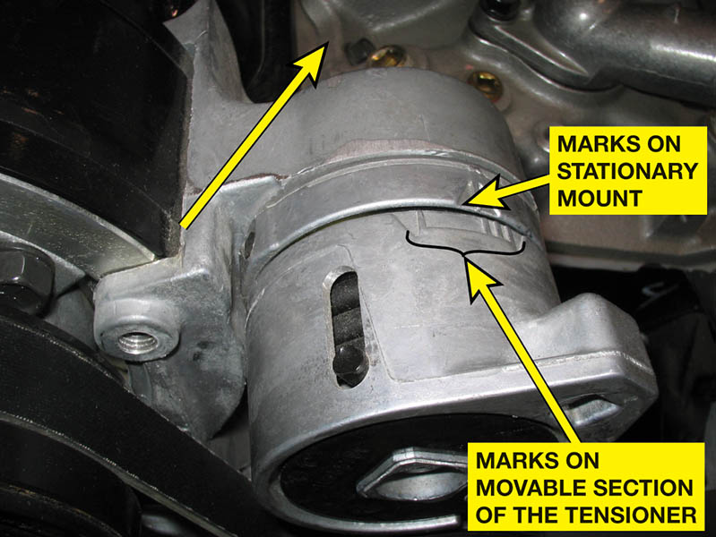
Figure 21.32 Typical marks on an accessory drive belt tensioner

Slide 63
COOLING SYSTEM SERVICE (1 of 2)
Flushing Coolant:
Cleaning cooling system and replacing the coolant.
Coolant Exchange Machine:
Exchange old coolant with new.
Hose Inspection:
Looking for hose abnormalities that would cause failures.

Slide 64
COOLING SYSTEM INSPECTION (2 of 2)
Disposing of Used Coolant:
Dispose according to state and local laws.
Cleaning the Radiator Exterior:
Removal of external plugging by dirt and insects.
Hose Clamps:
Check for proper position and tightness.

Slide 65
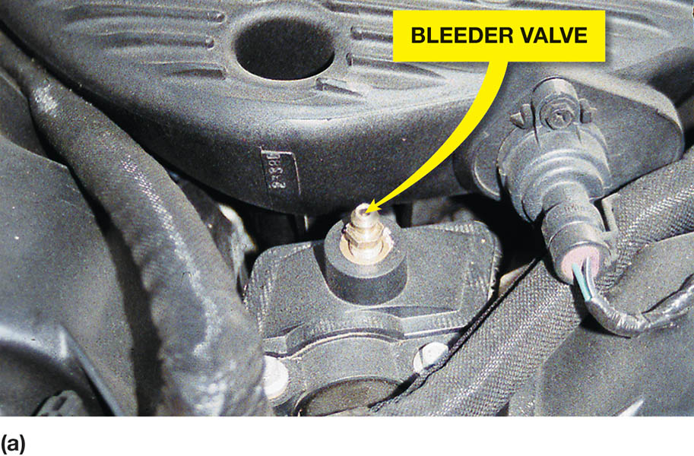
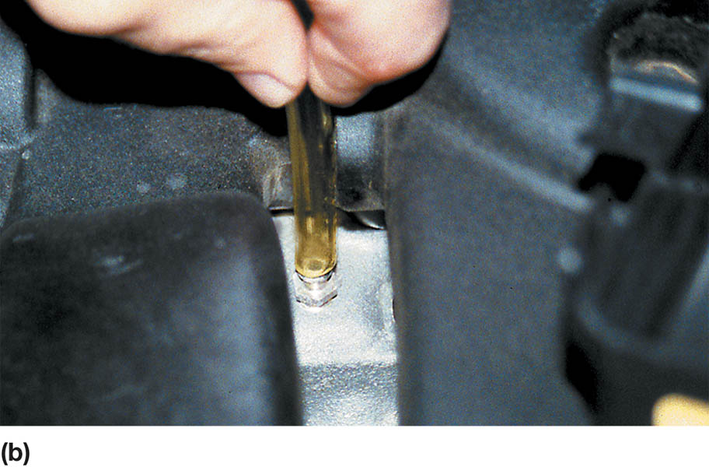
Figure 21.33 (a) Many vehicle manufacturers recommend that the bleeder valve be opened whenever refilling the cooling system. (b) Chrysler recommends that a clear plastic hose (1/4 inch ID) be attached to the bleeder valve and directed into a suitable container.

Slide 66
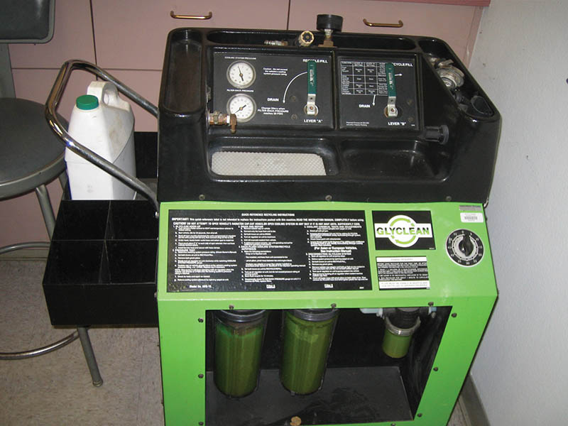
Figure 21.34 Using a coolant exchange machine helps eliminate the problem of air getting into the system, which can cause overheating or lack of heat due to air pockets getting trapped in the system

Slide 67
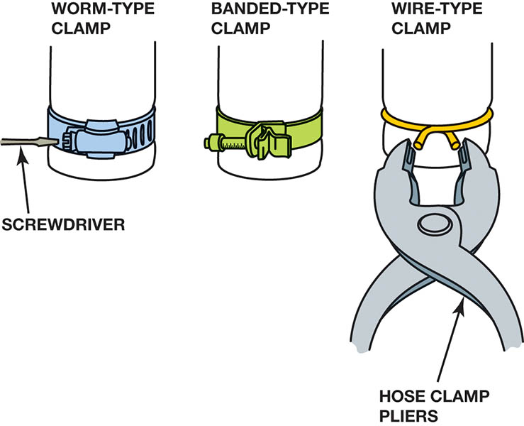
Figure 21.35 Hose clamps come in a variety of shapes and designs

Slide 68
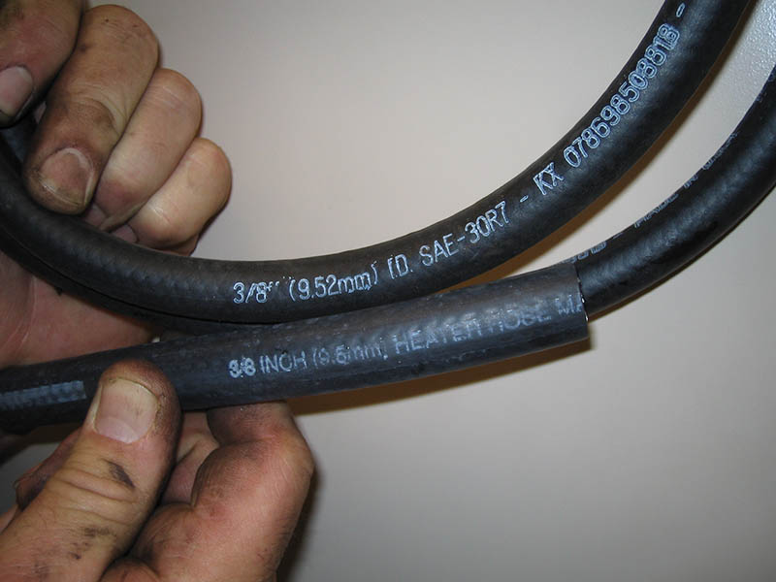
Figure 21.36 The top 3/8 inch hose is designed for oil and similar liquids, whereas the 3/8 inch hose below is labeled “heater hose” and is designed for coolant

Slide 69
Copyright

